Slide 1
Building and Sustaining High Functioning Teams FGFOA Gild Coast Chapter Conference, Largo, Florida
Presenter: Dr. Elvis Epps, Leadership Strategist & Coach, U.S. Navy Veteran

Slide 2
Contact information:
Dr. Elvis Epps
(407) 963-1253
elviseppsspeaks.com
elviseppsspeaks@gmail.com

Slide 3
Today’s goal is to explore and discuss what helps effective teams work harder and better and how they stay productive and successful for years.

Slide 5
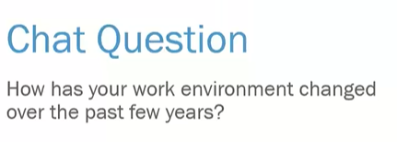

Slide 8
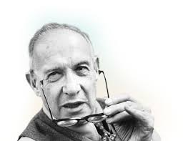
“Only three things happen naturally in organizations: friction, confusion, and underperformance.
Everything else requires leadership.”
--Peter Drucker

Slide 10
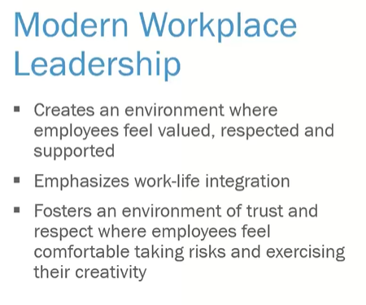

Slide 12
Characteristics of a Modern Day Leader

Slide 13
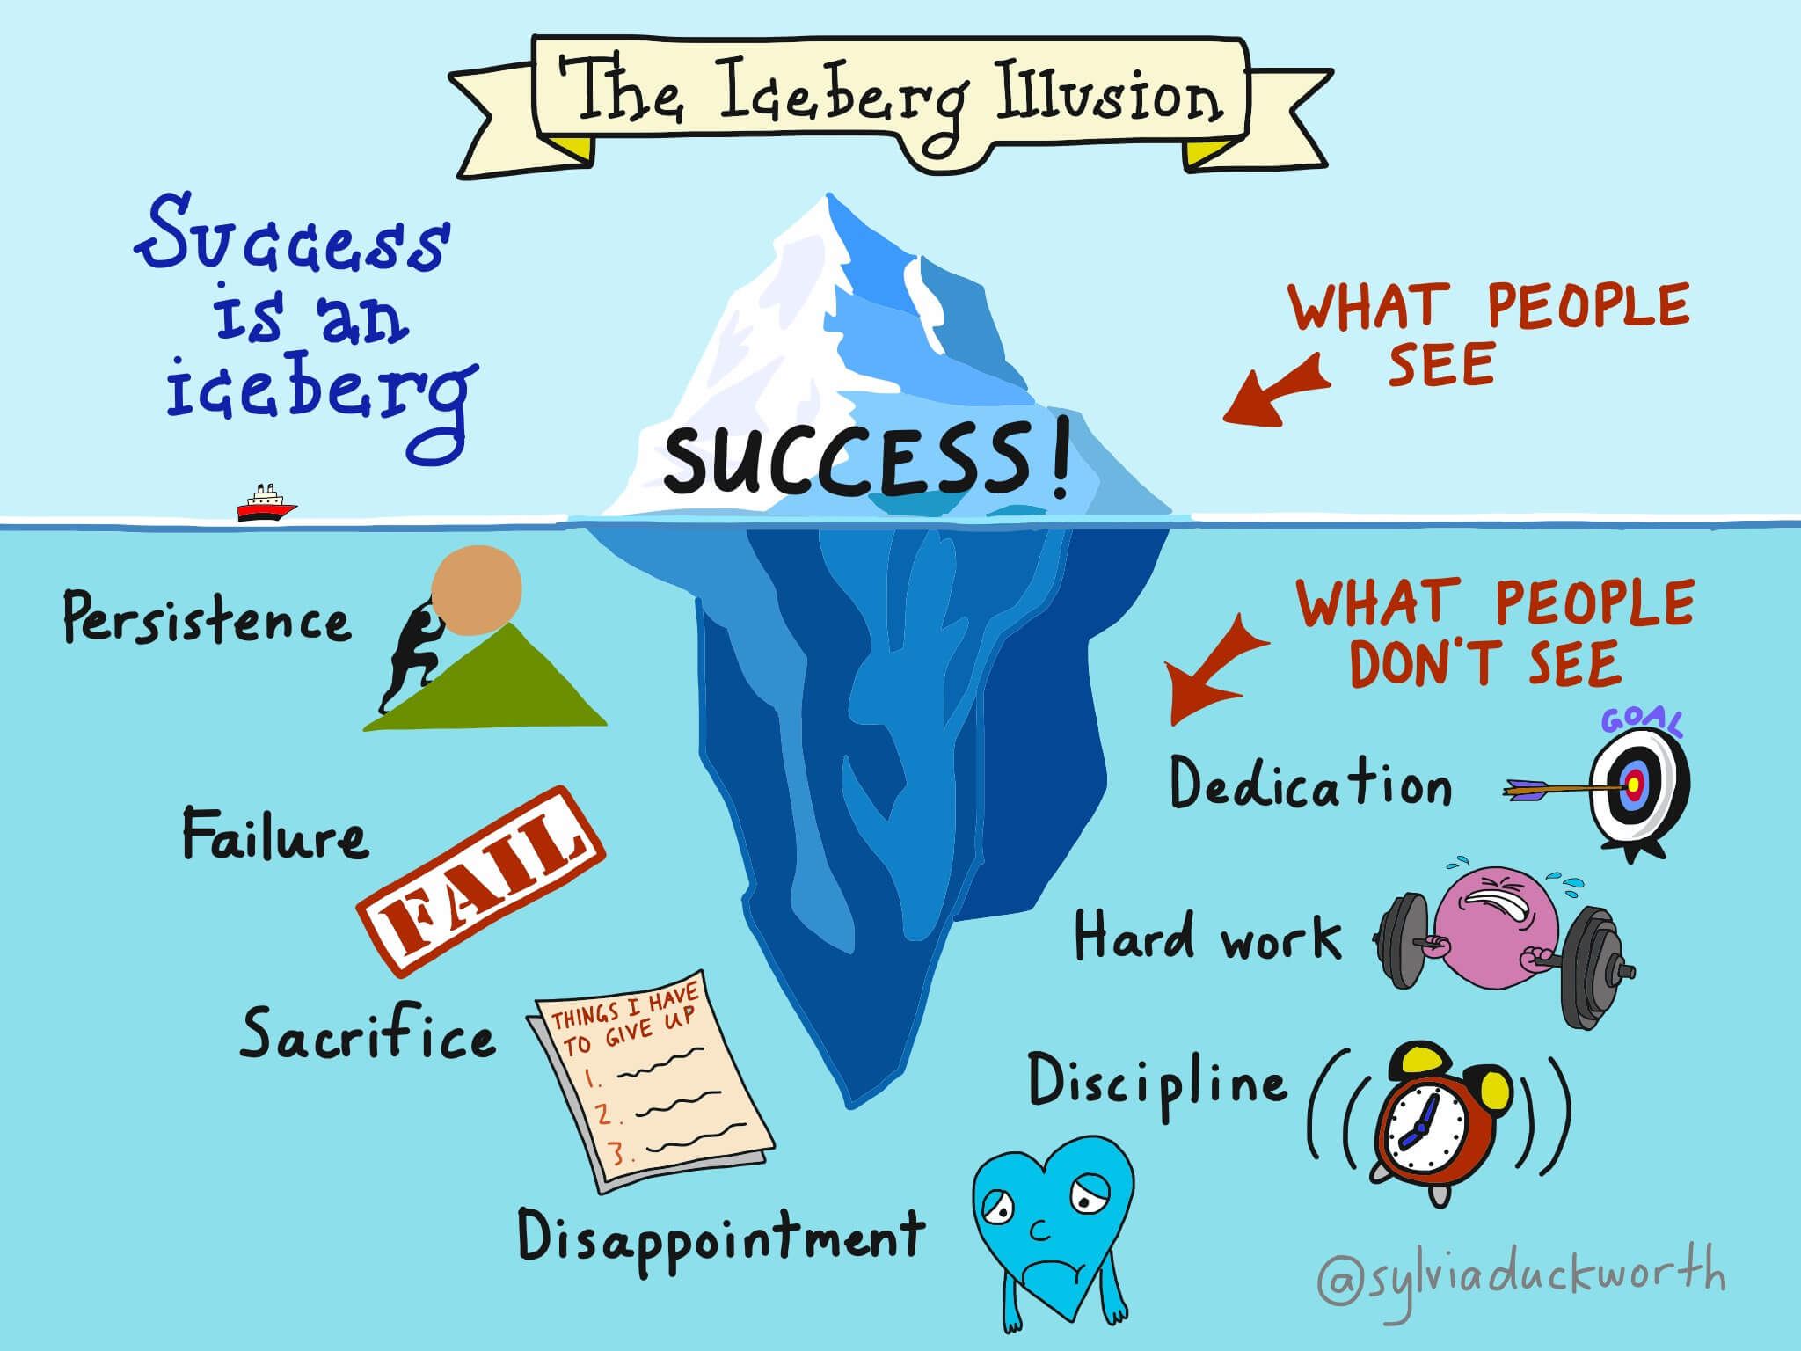
Notes:
At the tip of the iceberg – In the 10% floating above the surface, we have visible results. These might be successful results or failures. You might have landed the job of your dreams, or you might have failed an exam.
Below the surface – Then there’s the remaining 90% of the iceberg. This represents everything that the world doesn’t see. Here, we have everything that goes into that outcome. We have hard work, positive self-talk, and so forth. Or, we might have deeply set beliefs that unconsciously shape our behaviors. Think: “What’s the point in studying anymore? I can’t do any better.” Or think about hard work, repeated effort, and telling yourself: “I’ve got it in me. Let’s try again, but smarter.”
By confronting these hidden beliefs and schemas with questions, we stand a much better chance of developing a growth mindset.

Slide 16
Top Sources of Job Stress
Source: Wrike: https://www.wrike.com/blog/stress-epidemic-report-announcement/ Dynamic Signal: https://dynamicsignal.com/2019/03/20/2019-employee-communication-and-engagement-study/ Korn Ferry: https://www.kornferry.com/insights/articles/workplace-stress-motivation D

Slide 18
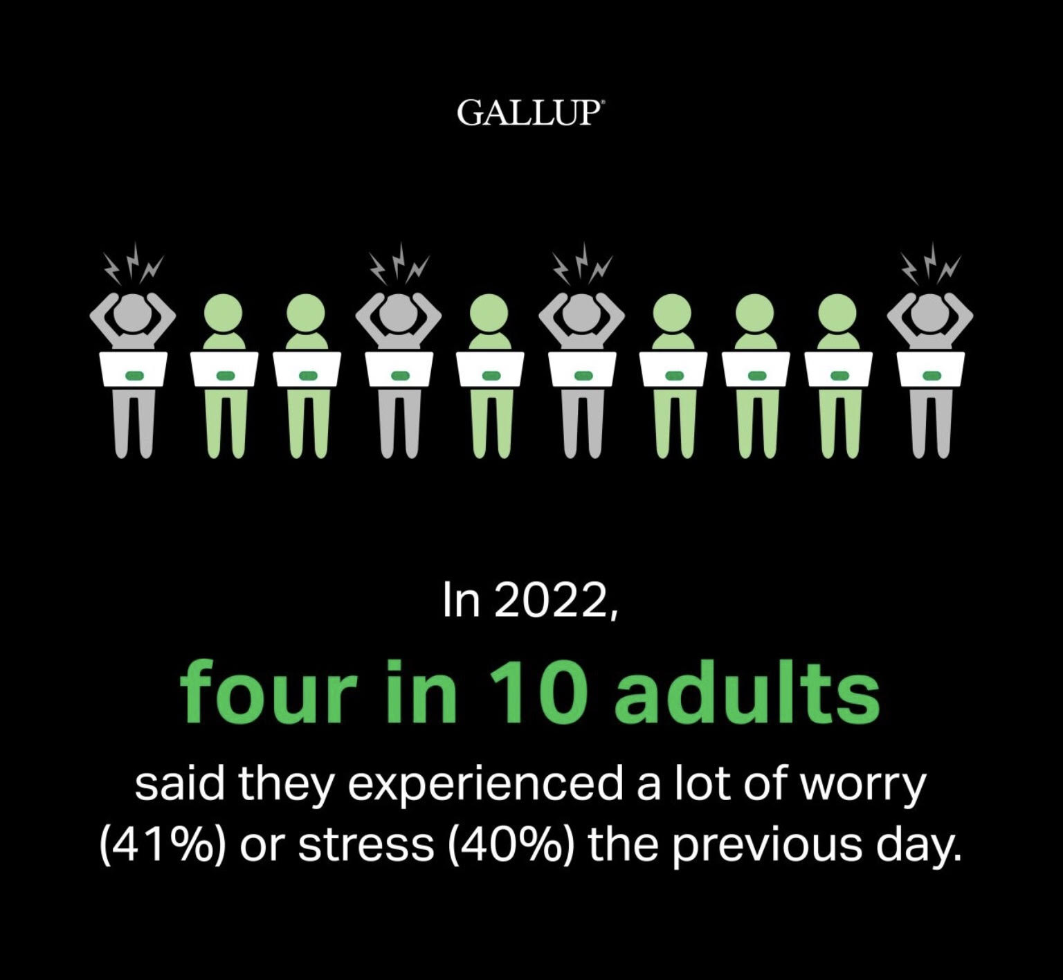

Slide 19
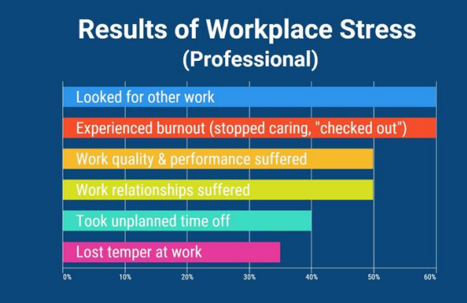
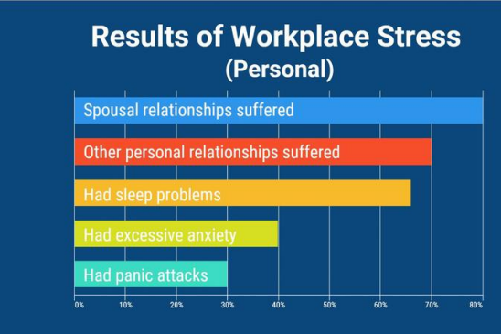
The Impact of Job Stress

Slide 20
Impact of Job Stress by Generation

Slide 21
Impact of Job Stress by Generation

Slide 22
How to Deal with Stress Men and women handle stress slightly differently:
While both tend to sleep more, women also choose to eat (46%) and talk to family and friends (44%) while these fall further down the list for men (eating 27% and talking 21%).
Both used some strategies at the same rate: caffeine (31%), smoking (27%), exercise (25%), over the counter or prescription drugs (23%), and alcohol (20%).
Source: Anxiety & Depression Association of America: https://adaa.org/workplace-stress-anxiety-disorders-survey Mental Health America: https://www.mhanational.org/sites/default/files/Work%20Health%20Survey%202019.pdf

Slide 23
The Impact of Stress and Distractions Have on Work Productivity

Slide 24
The United States' National Institute for Occupational Safety and Health defines job stress as the harmful physical and emotional responses that occur when the requirements of the job do not match the capabilities, resources, or needs of the worker. Job stress can, in turn, lead to poor health and even injury. National Life revealed that about 40% of workers reported that their jobs were extremely stressful.
Source: https://www.corporatewellnessmagazine.com

Slide 25
Workplace stressors are classified as physical and psychosocial.
Physical stressors include noise, poor lighting, poor office or work layout, and ergonomic factors, such as bad working postures.
Psychosocial stressors are, arguably, the most predominant stress factors. These include high job demands, inflexible working hours, poor job control, poor work design and structure, bullying, harassments, and job insecurity.

Slide 26
Ways Stress Impacts the Body
Elevated blood pressure and anxiety
Sleepless nights
Coronary heart disease
Substance abuse
Burnout
Depression
Poor dietary patterns
Workplace stress reduces employee productivity
Increases absenteeism and presenteeism
Increases the number of days taken off work for doctor visits
Tension among teams, managers, and leaders

Slide 27
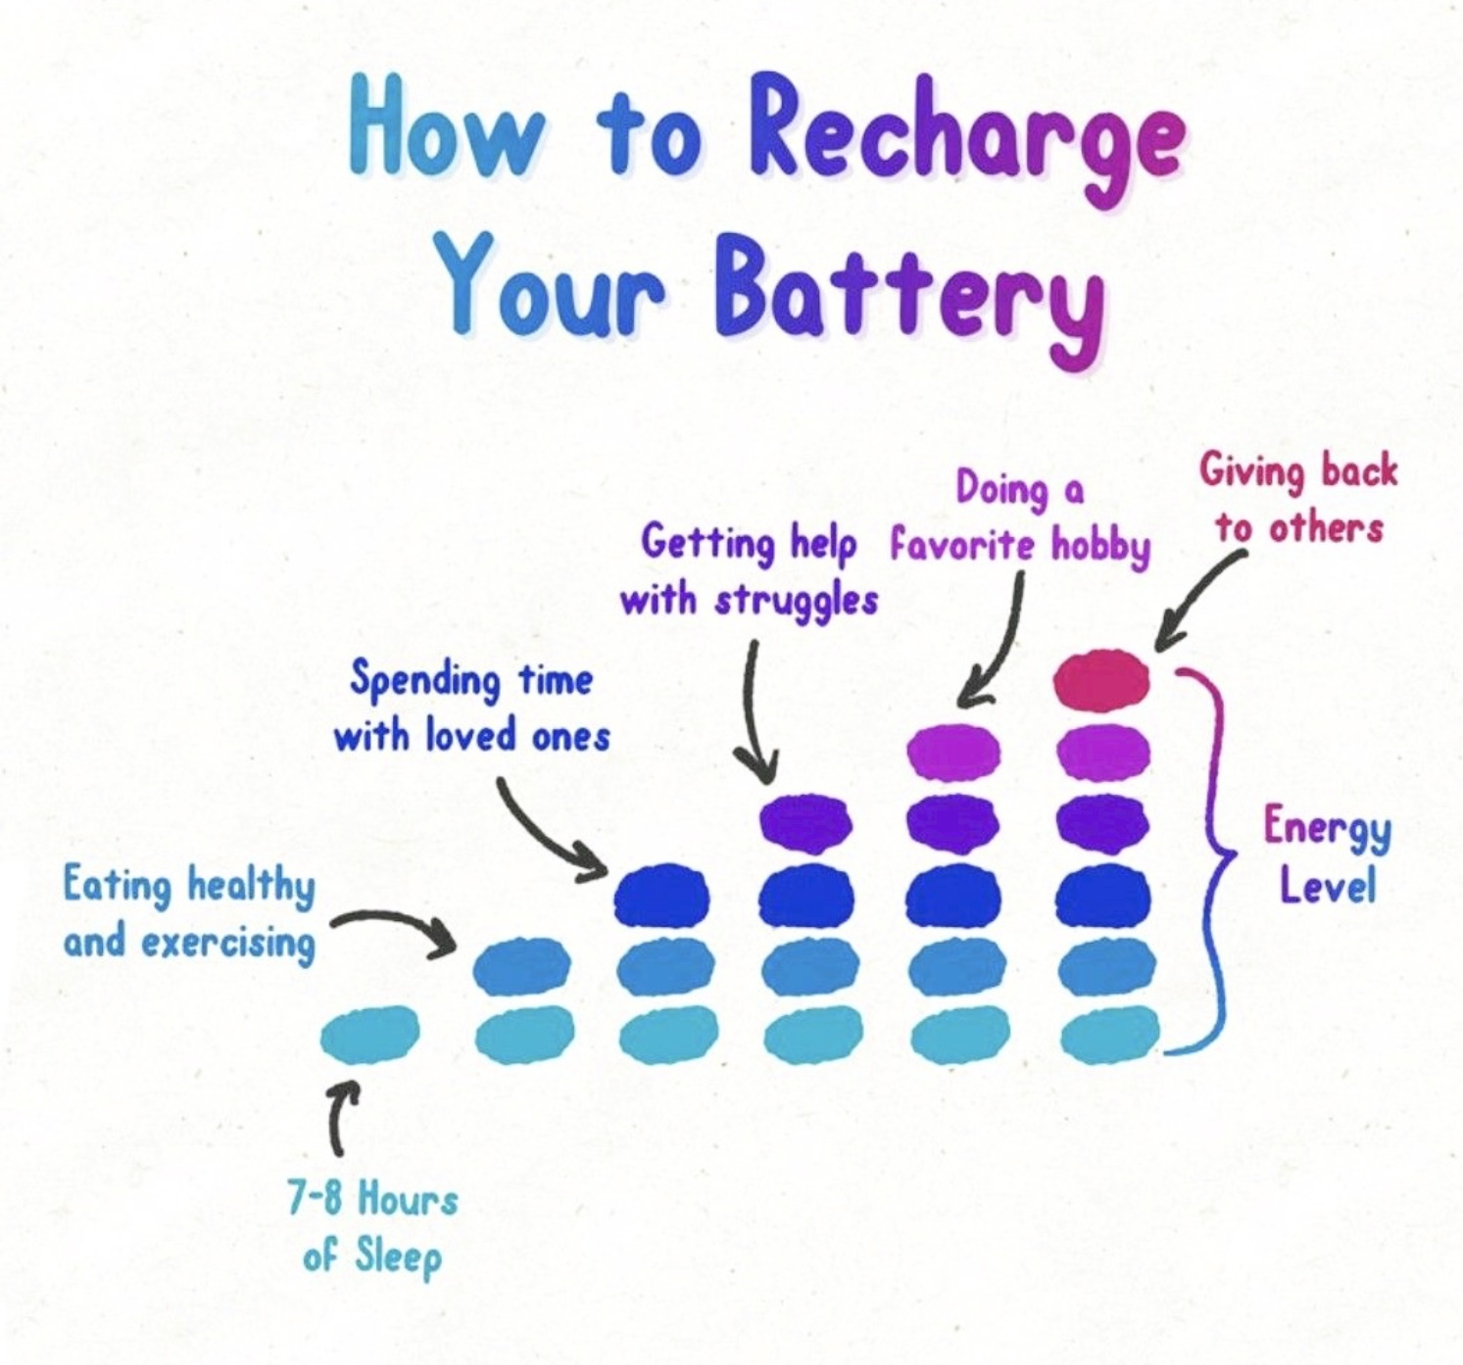
Recharge, Reflect, Reignite
"Taking care of yourself doesn’t mean me first; it means me too." ---L.R. Knost

Slide 29
Listed are examples of how to find Hygge in the little things that we could miss every day
Take your vacation time! Have a few restorative hygge days at home if you can’t travel.
Don’t succumb to presenteeism: if you’re sick, stay home and properly recover. Look after yourself during that time.
Bake something for your co-workers and enjoy fika – the Swedish word for a coffee and cake break.
Have a favorite work mug and a regular afternoon cup of tea routine. It will give you a welcome break during that afternoon slump time of day.
Get outside at lunchtime to give yourself a boost with fresh air and natural light. Get some steps in, maybe do some window shopping. Anything nice to get away from your desk.
Listen to a favorite radio station or have a productivity playlist. You can also try brown noise apps – it’s like white noise but is meant to help you concentrate.
Review your work/life balance and try to stop taking work home with you unless essential. Use the time to do something hygge instead.

Slide 30
Activity: Positive Emotion Brainstorm
This exercise aims to generate possible ideas to increase positive emotions in your daily life. More specifically, this exercise targets the type of positive emotions that are experienced the least often; that is, they are most underrepresented in his/her day-to-day life.
Step 1: From the list provided, which of the ten positive emotions do you feel the least daily and, consequently, want to bring into your life? Choose one grouping to work with.
Types of Positive Emotion:
1. Amused, fun-loving, or silly 2. Awe, wonder, or amazement
3. Grateful, appreciative, or thankful 4. Hopeful, optimistic, or encouraged
5. Inspired, uplifted, or elevated 6. Interested, alert, or curious
7. Joyful, glad, or happy 8. Love, closeness, or trust
9. Proud, confident, or self-assured 10. Serene, content, or peaceful

Slide 31
Step 2: Take ten minutes to reflect on how you can increase the opportunities in your life to experience those three emotions. Let your mind wander and do not limit your possibilities. Your ideas should be true to you. Aim for at least 15 ideas.
Possible categories for your ideas include:
■ Activities that you already do but could do more often
■ Changing your mindset about current activities
Remember, this is simply a brainstorming activity. You don’t need to take action on all these ways to increase the positive emotions in your life.

Slide 32
7 Self-Care Reflective Questions
1. What activities or practices make you feel rejuvenated and centered? 2. How do you recognize when you’re neglecting yourself? 3. What boundaries have you set for yourself to protect your personal time and well-being? 4. What self-care routines or rituals have you found beneficial in the past? 5. What support or resources do you need to enhance your self-care practices? 6. What beliefs or thoughts might be holding you back from prioritizing self-care? 7. How can you hold yourself accountable for maintaining regular self-care practices?

Slide 33
Ways to Build and Sustain High-Performing Teams and Expectations

Slide 34
Build a foundation of Trust
If your interactions with employees sound more like nails on a chalkboard instead of a symphonic masterpiece, try rebuilding trust — it’s the bedrock of leadership and management.
Are your working relationships built on a solid foundation, or do you find them on shaky ground? Without a strong bond and mutual trust, leading the team to success will be difficult. Your employees should trust your leadership skills and look to you for guidance.

Slide 35
Trust Do’s
Participate in day-to-day activities and make yourself available for questions
Make an effort to learn something about each of your employees
Be fair and consistent with both rewards and reprimands
Be true to your word
Involve staff in important decisions to show you value their input
Be a good listener
Recognize an employee’s contribution rather than taking credit for results
Make commitments, not promises

Slide 36
Trust Don’ts
Micromanagement
Pridefulness or lack of humility
Failure to build relationships with individual team members
Dictatorial behavior
Failure to listen and accept other viewpoints
Failure to admit your mistakes or accept that others make mistakes

Slide 37
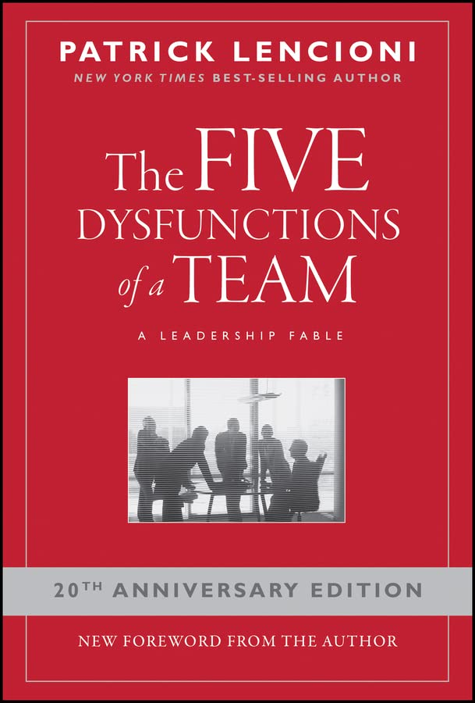

Slide 39
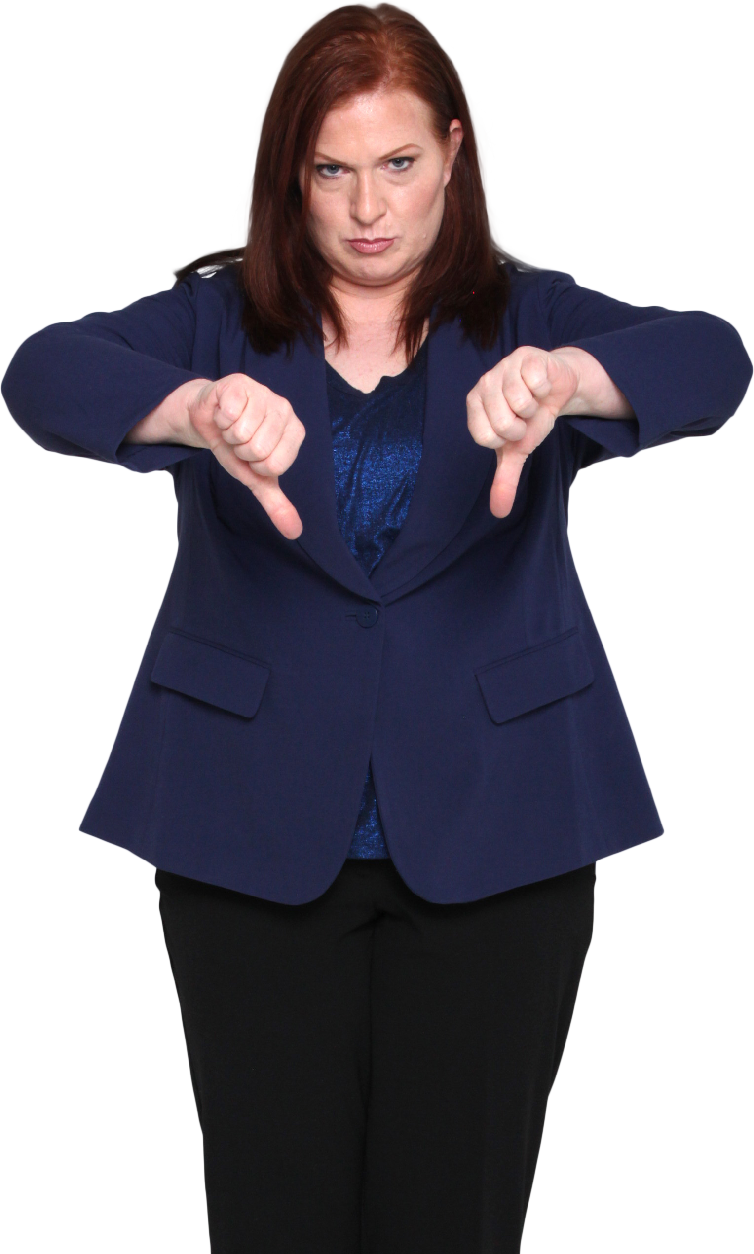
There’s One in Every Company
Toxic Workers: 8 Types That Can Kill Your Business

Slide 40
8 Toxic Types That Can Kill Your Business
The Silo
Silos are those that like to say, “That’s not my job – it’s not in my job description.” They will turn their back on helping out colleagues or joining in on collaborative efforts simply because it’s “beneath” them, it it doesn’t necessarily affect them directly. They quickly destroy company or team performance.
The Veteran
This has nothing to do with age or military service. They believe they’ve paid their dues and earned a place in some fictional company Hall of Fame. They feel that because of their time served or battles won, they no longer have to work hard or produce results.

Slide 41
8 Toxic Types That Can Kill Your Business
The Experienced One
The Experienced One is quick to brag about past accomplishments or tell the same stories of victory over and over again, but they don’t contribute to any new achievements.
The Armchair Manager
Armchair Managers attend meetings and witness important conversations and big decisions. They might chime in with comments of affirmation or positive feedback. But then once adjourned, they organize unofficial meetings after the meeting to discuss and bring into question those same conversations and decisions.
They completely defeats the momentum of the group and works against the goal of the company.

Slide 42
8 Toxic Types That Can Kill Your Business
The Gossip
The Gossiper is the one that is usually at the root of off-topic talks about their colleagues. “Did you hear about Jennifer? I am not one to gossip, but she screwed up another order.” They spread rumors and instigate negative conversations. They waste valuable time on the job, create unnecessary drama, and diminish the dignity and respect of other employees.
The Squelcher
Squelchers are threatened by strong performers, and don’t hesitate to make sure they spread the word that “When you work so hard, it makes the rest of us look bad.”
Squelchers try to bring high-achieving workers down to their own level of low productivity so that they won’t stand out as a bad employee or manager.

Slide 43
8 Toxic Types That Can Kill Your Business
The Star
The Star isn’t content to share the glory or give credit to others. The Star wants everyone to know that “That was my idea!” They tend to be self-centered and want recognition for what they think they deserve.
The Blamer
No matter how great your service or product is, things always go wrong. Blamers are quick to point fingers and make it clear that it’s someone else’s fault. Blamers are less concerned with finding a resolution and more concerned with defending themselves. They reject the notion that “We’re all in this together” and instead look out for themselves.

Slide 44
Establish Clear Expectations
Setting Goals: Define clear and measurable goals for the team.
Goals should be aligned with the organization’s mission and vision.
Goals should be specific, measurable, achievable, relevant, and time-bound.
Defining Roles and Responsibilities: Clearly define the roles and responsibilities of each team member.
Roles should be aligned with the team’s goals and objectives.
Responsibilities should be communicated and understood by all team members.
Notes:
Setting clear expectations is essential for building and sustaining high functioning teams. By defining clear goals, roles, and responsibilities, team members can work together more effectively and efficiently, and achieve better results.

Slide 45
Effective Communication
Active Listening and Clear Feedback:
Actively Listening: Listen actively and attentively to team members.
Encourage team members to express their ideas and opinions.
Clarify understanding by asking questions and paraphrasing.
Clear Feedback: Provide clear and constructive feedback to team members.
Focus on specific behaviors and actions
Use “I” statements to express your own feelings and perceptions.
Notes:
Effective communication is essential for building and sustaining high functioning teams. By practicing active listening and providing clear feedback, team members can improve their understanding and collaboration, and achieve better results.

Slide 47
Trust Building
Vulnerability and Accountability
Share personal experiences and feelings
Build empathy and understanding
Vulnerability: Encourage team members to be vulnerable and open with each other.
Accountability: Hold team members accountable for their actions and decisions.
Set clear expectations and consequences
Follow through on commitments
Notes:
Building trust is essential for building and sustaining high functioning teams. By encouraging vulnerability and accountability, team members can build stronger relationships and work together more effectively.

Slide 48
Leaders Create an Environment of Psychological Safety
Psychological safety is believing you won't be punished or humiliated for speaking up with ideas, questions, concerns, or mistakes.
It is important to create a positive and inclusive work environment where individuals feel comfortable and empowered to contribute their best.

Slide 50
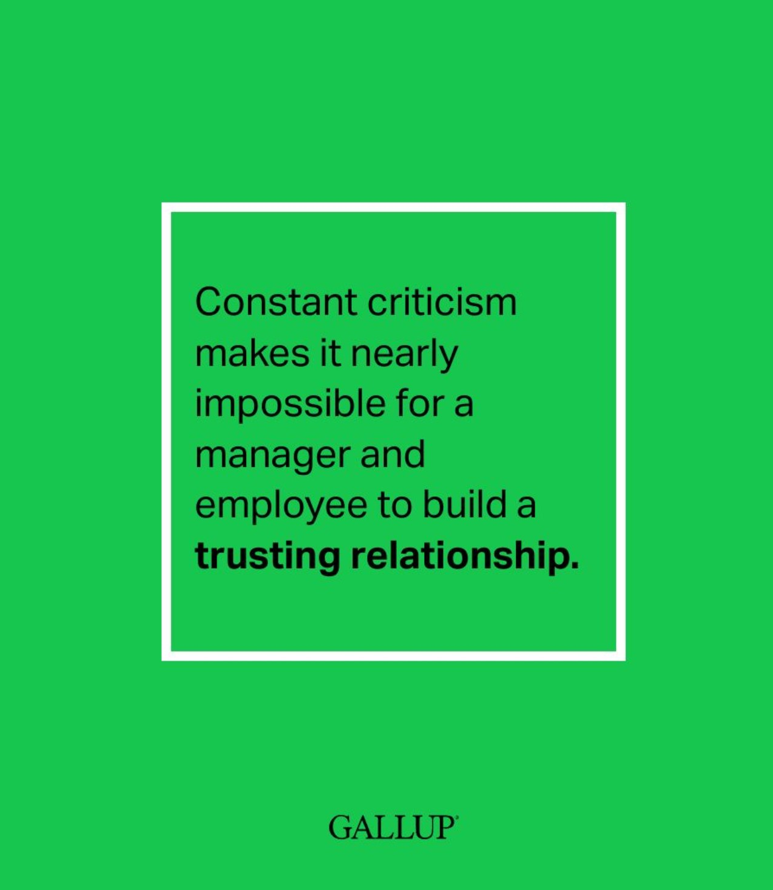

Slide 51
Collaboration
Sharing Skills and Knowledge
Sharing Skills: Encourage team members to share their skills and expertise with each other.
Identify areas of expertise and interest
Provide opportunities for cross-training and mentoring
Sharing Knowledge: Encourage team members to share their knowledge and experience with each other.
Share best practices and lessons learned
Provide opportunities for knowledge sharing and collaboration
Notes:
Collaboration is essential for building and sustaining high functioning teams. By sharing skills and knowledge, team members can work together more effectively and efficiently, and achieve better results.

Slide 52
Conflict Resolution
Active Listening and Compromise
Active Listening: Listen actively and attentively to team members.
Encourage team members to express their concerns and perspectives
Clarify understanding by asking questions and paraphrasing
Compromise: Find common ground and work towards a mutually beneficial solution.
Identify areas of agreement and disagreement
Brainstorm creative solutions and evaluate their feasibility
Notes:
Conflict resolution is essential for building and sustaining high functioning teams. By practicing active listening and compromise, team members can resolve conflicts more effectively and maintain positive relationships.

Slide 53
Diversity and Inclusion
Different Perspectives: Embrace diversity of thought and perspective.
Encourage team members to share their unique perspectives and experiences
Challenge assumptions and biases
Benefits of Different Perspectives and Experiences
Different Experiences: Embrace diversity of experience and background.
Recognize the value of different skills and knowledge
Create a culture of inclusion and respect
Notes:
Diversity and inclusion are essential for building and sustaining high functioning teams. By embracing different perspectives and experiences, team members can improve their creativity, innovation, and problem-solving abilities.

Slide 54
Effective ways to maintain harmony among your diverse workforce
Successful leaders know their team members and tailor their approach to everyone's needs.
Experienced Fast-paced Low emotional intelligence
Newbie Low-key Extrovert In–office
Energetic High emotional intelligence Slow and steady
Team player Introvert Remote Soloist

Slide 55
Recognition and Feedback
Positive Reinforcement: Recognize and reward team members for their achievements and contributions.
Provide specific and timely feedback
Celebrate successes and milestones
Positive Reinforcement and Constructive Criticism
Constructive Criticism: Provide constructive criticism to help their performance.
Focus on specific behaviors and actions
Provide actionable feedback and suggestions for improvement
Notes:
Recognition and feedback are essential for building and sustaining high functioning teams. Team members can improve their motivation, engagement, and performance by providing positive reinforcement and constructive criticism.

Slide 56
6 rules to handle difficult conversations
Difficult conversations are unavoidable and often uncomfortable. These six techniques can smooth the conversation:
Conquer your fears. Don’t put off the conversation.
Do your homework. Come prepared for the meeting with fact-based evidence.
Focus on the performance, not the person.
Be positive and assume good intentions.
Leave your emotions at the door.
Find the right, safe setting – your office, a conference room, or a coffee shop.

Slide 57
Four discipline steps to correct harmonic dissonance
Disciplining employees is a difficult, but important aspect of managing people.
Left unaddressed, a disruptive employee can lead to disengaged employees, low morale, decreased productivity and lost profits.
A progressive discipline policy provides transparency and accountability.
1. Verbal Warning 2. Written Warning 3. Final Warning 4. Termination

Slide 58
Continuous Learning
Professional Development Provides opportunities for team members to learn and grow.
Offer training and development programs
Encourage participation in conferences and workshops
Continuous Learning: Emphasize the importance of continuous learning and improvement
Encourage teams to seek out new challenges and opportunities
Foster a culture of curiosity and innovation
Notes:
Continuous learning is essential for building and sustaining high functioning teams. By providing professional development opportunities and emphasizing the importance of continuous learning, team members can improve their skills, knowledge, and performance.

Slide 59
Celebrating Success
Team building activities and recognition programs
Team Building Activities: Plan team-building activities to celebrate successes and build relationships.
Organize social events and outings
Participate in team-building exercises and games
Recognition Programs: Implement recognition programs to reward and motivate team members.
Offer incentives and bonuses for outstanding performance
Recognize team members for their achievements and contributions
Notes:
Celebrating success is essential for building and sustaining high functioning teams. By planning team building activities and implementing recognition programs, team members can improve their motivation, engagement, and satisfaction.

Slide 60
7 ways to reward excellence
1. Be flexible.
2. Write employees a handwritten thank–you note.
3. Organize an off-campus outing.
4. Buy lunch for the team.
5. Award a traveling trophy to outstanding employees.
6. Create a VIP parking spot.
7. Offer learning opportunities.

Slide 61
Put your top performers on center stage
Appreciation and recognition help motivate and engage employees, but they’re not the same thing. Here’s how to decide which to use:
Employee appreciation Designed to enhance employee morale Marks milestones (birthdays, anniversaries, achievements) Can complement a peer-to-peer appreciation program Uses rewards like feedback, acknowledgment or bringing cake for birthdays
Employee recognition Rewards employee performance that achieves company goals Highlights top performers while encouraging others Celebrates company priorities and individual achievement Is measurable and simple to implement, maintain and repeat Uses individual rewards like raises, bonuses, gifts, and promotions

Slide 62
“I suppose leadership at one time meant muscles, but today it means getting along with people.”
– Mahatma Gandhi

Slide 63
So, what kind of leader are you?
Do you inspire and motivate your employees to their best performance?
Does your style – whether you’re a strong, quiet leader or a charismatic, fun-loving boss – jive with your team’s needs?
Are you trusting and trustworthy?
Do you keep the big picture in mind?

Slide 64
Create and support a noteworthy team
Do you take the time to get to know your employees?
Do you clearly communicate your expectations?
Are you a micromanager, or do you get out of the way and let employees do their jobs?
Do you strive to hire the best people for the job?
Do you delegate tasks or hold onto them out of fear?
Do you create opportunities for your employees to continue learning and developing?
Do you cultivate trust with your employees?

Slide 65
Good leaders:
Organizes, plans, and oversees the day-to-day processes
Ensures deadlines and goals are met
Assigns and delegates work
Provides employees with clear, consistent expectations

Slide 66
“A genuine leader is not a searcher for consensus but a molder of consensus.”
– Martin Luther King Jr.

Slide 67
True for both leaders and managers
Whether you consider yourself a leader or a manager – or both – you must strike a balance between acting as one or the other. And sometimes, you may find you need to sharpen your skills more in one area. To know when to concentrate on each, ask yourself these questions:
Is the work getting done well without my intervention?
Do you focus on results or processes (how the job got done)?
Who is responsible when things go wrong?
What do you spend the most time talking about? The tasks at hand, processes, and deadlines, or the big picture and strategy?
Do you ask employees to accomplish objectives without explaining the need behind the request?

Slide 68
Practice, Practice, Practice
Techniques for continual improvement:
Build a strong professional network. Being surrounded by other successful people can inspire and support you when things get tough.
Pursue training opportunities outside of the office. Sometimes you need a different perspective.
Take care of yourself. The better your health, the better you’ll be able to handle anything that comes your way.
Stay current on industry trends. Your team looks to you for expertise.
Work in other areas of the business if possible. It will broaden your horizons and increase your value to the company.

Slide 69
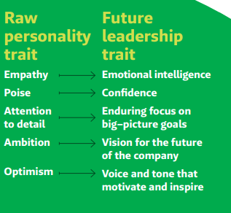
How to build leadership capacity
Seek these five raw personality traits that are present in inspirational leaders.

Slide 70
When should you promote your employee to the leadership/management team?
Ask these questions before promoting a high performer to management:
Does the employee have the right motivation? Driven to get things done or by the need to advance into leadership?
Do they have the necessary skills? Are they leading or mentoring peers? Understand the “why” behind their work? Big-picture thinker?
Have you prepared them for leadership? Provide mentorship and leadership opportunities, offer training and give feedback.
Are you ready? If a top contributor moves into leadership, expect a drop in team productivity, at least temporarily.

Slide 71
Conclusion
Key insights and tips for Building and Sustaining High Functioning Team.
Key insights. Building and sustaining high functioning teams requires clear expectations, effective communication, trust building, collaboration, conflict resolution, diversity and inclusion, recognition and feedback, continuous learning, and celebrating success.
Tips for Building and Sustaining High functioning Teams. Set clear goals, roles, and responsibilities; practice active listening and clear feedback; encourage vulnerability and accountability; embrace diversity and inclusion; provide recognition and feedback; offer professional development opportunities; and celebrate.
Notes:
Inconclusion, building and sustaining high functioning teams is essential for achieving success in any organization. By following the tips and strategies presented in this presentation, team members can improve their collaboration, communication, and performance and achieve better results.

Slide 72
8 Benefits of great leaders and managers
Culture of trust and understanding
Employees feel understood
Greater resilience in crises
Enthusiastic, engaged employees
Lower turnover and better retention
Higher productivity and efficiency
Increased bottom line
Less wasted time

Slide 73
Contact information:
Dr. Elvis Epps
(407) 963-1253
elviseppsspeaks.com
elviseppsspeaks@gmail.com

