Slide 1
Financial Transparency
Spending in the Sunshine

Slide 2
“Spending in the Sunshine (SITS) is a state-of-the-art transparency website that allows users to view County spending for departments under the Pinellas County Board of County Commissioners and Clerk of the Circuit Court & Comptroller. With real time data on payroll and operational spending, citizens get a first-hand look at how their tax dollars are being spent.”

Slide 3
Agenda
Key features
Website Overview
Payroll Expenses
Vendor, Department and Category Spend
Legal Concerns
Quality Control
Success Stories & Impact
Q&A

Slide 4
Key Features
Real-time spend data
Access to payroll data for all employees
Access to spend data by vendor, department, and category
Drilldown and export functionality
No subscription fee
24/7 access
No sign up required

Slide 5
Website Overview

Slide 6
Site History
Legacy site go-live January 2014
Current site go-live May 2022

Slide 7
Transparency Spending Users
Citizens
Management
Elected Officials
Vendors
Media

Slide 8
Website Overview
Link: sits.mypinellasclerk.gov
Numerous ways to access
Search browser accessible
Instructions for navigating website

Slide 9
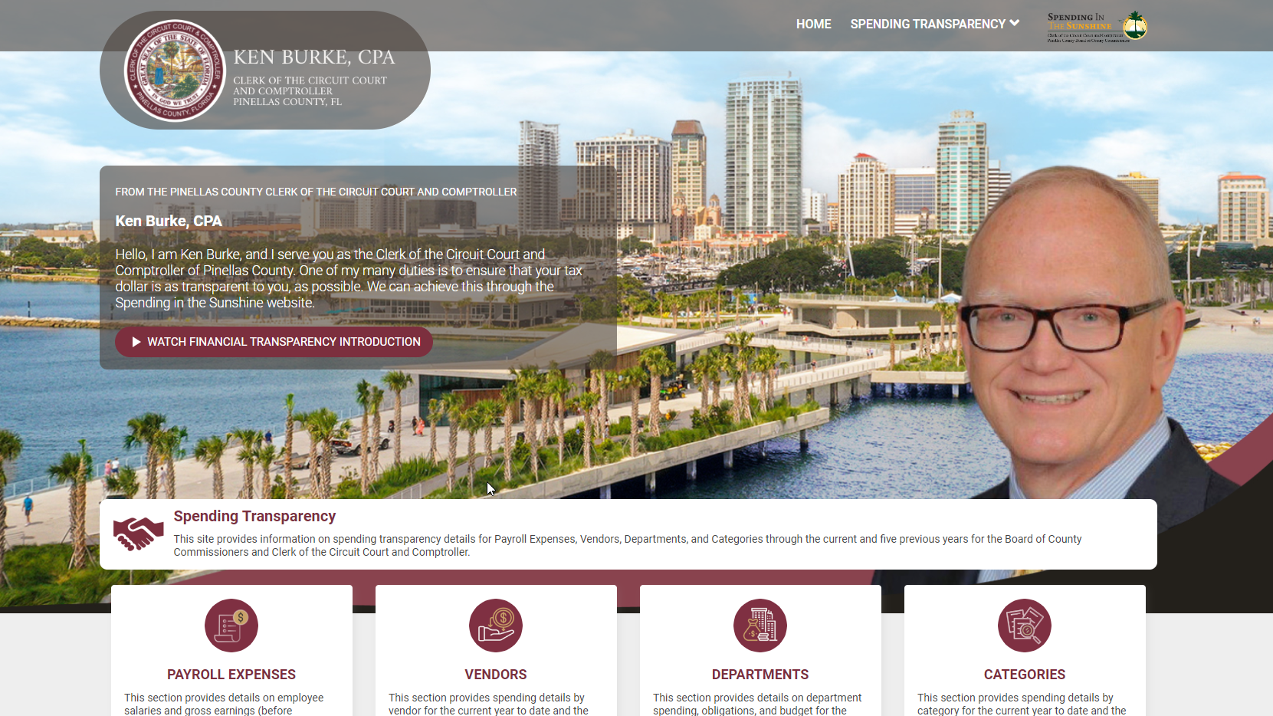

Slide 10
Instructional Videos
Provide an overview of the website and functionality
Enable users to utilize features
Allow for successful navigation

Slide 11
Getting The Word Out
Social media
Board meetings
Department meetings
Citizen interactions
Conferences

Slide 12
Payroll Expenses
Employee Spend

Slide 13
Payroll Expenses
Employee salaries and gross earnings before deductions
Organized by agency and fiscal year
Includes past five fiscal years
Visualizations on total payroll expenses, mean and median spend, and pay category
Comparative data on average salary vs. number of employees, regular vs overtime pay, and salary bands
Detail by employee, title, department, annual salary and gross earnings year to date

Slide 14
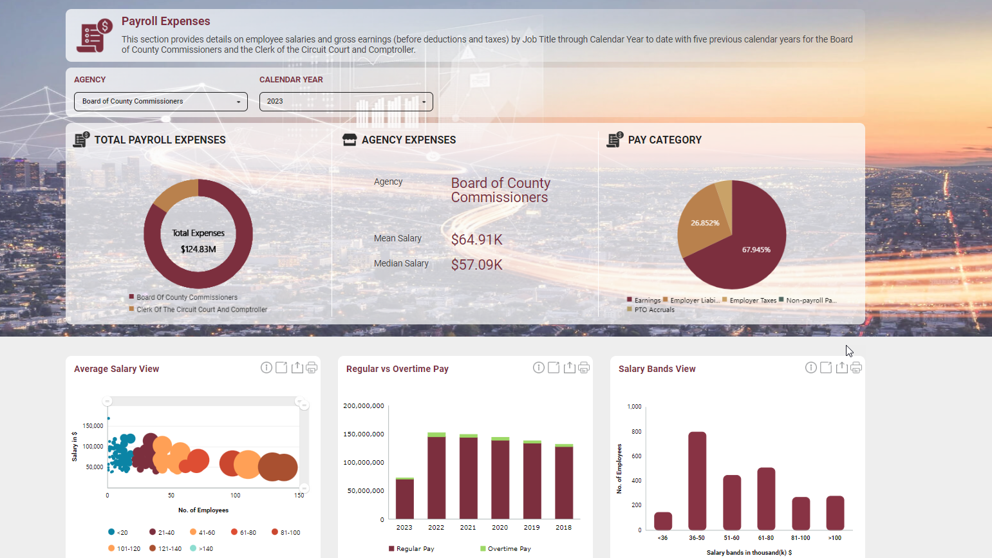

Slide 15
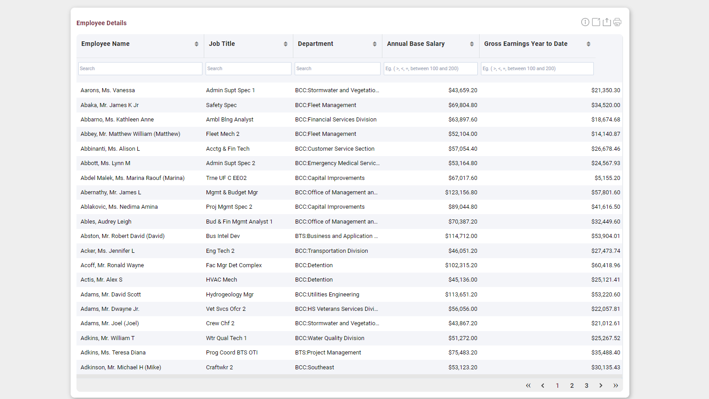

Slide 16
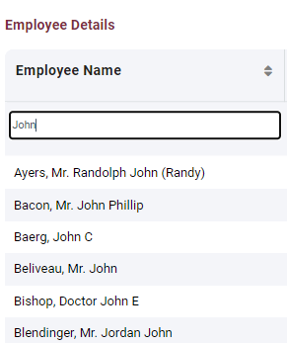
Payroll Expenses Employee Detail
Filters
Name
Job Title
Department
Annual Base Salary with parameters
Gross Earnings Year to Date with parameters

Slide 17
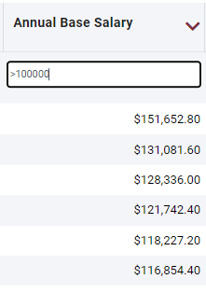
Payroll Expenses Employee Detail
Sorting
Alphabetically
By amount
Combine with filters to narrow results

Slide 18
Payroll Expenses Employee Detail
Export in a variety of formats for further analysis

Slide 19
Vendor Expenses
Spend By Vendor Payee

Slide 20
Vendor Expenses
Vendor spend data
Organized by agency and fiscal year
Includes past five fiscal years
Visualizations for total vendors, vendor spend to date, and new vendors
Detail by vendor name, years of association, associated departments, operating categories, current year spend, and obligation amount
Any spend that is protected legally from public disclosure or presents an operational concern is hidden

Slide 21
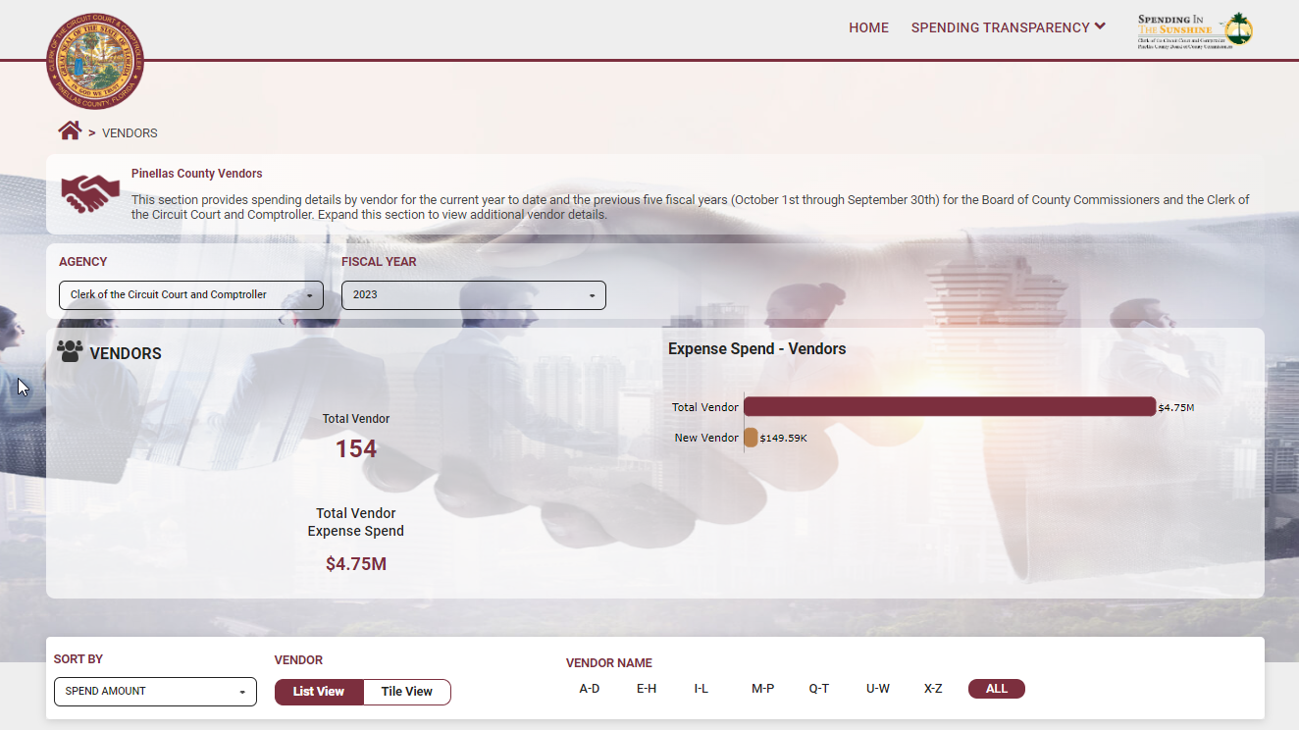

Slide 22
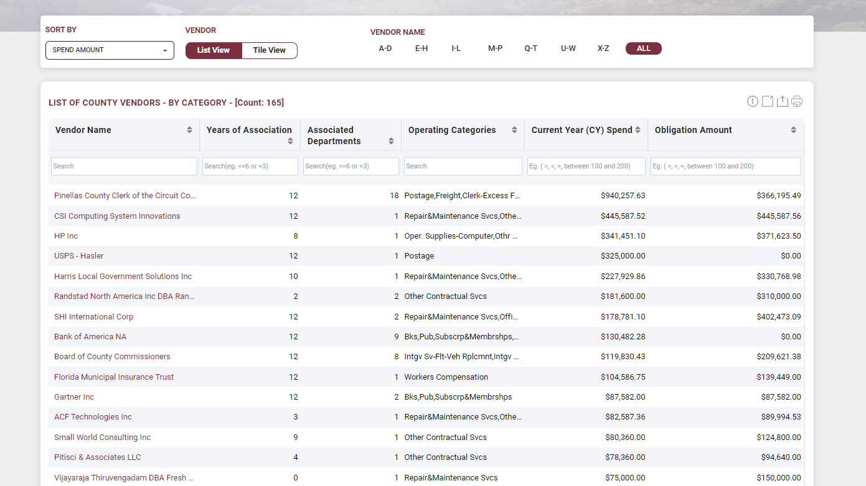

Slide 23
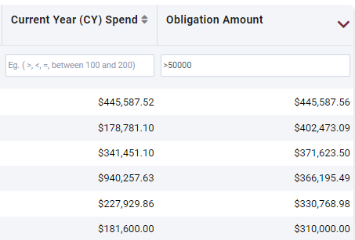
Vendor Expenses Expense Detail
Sorting:
Alphabetically
By amount
Combine with filters to narrow results

Slide 24
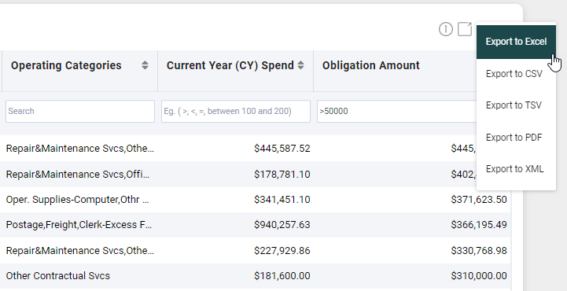
Vendor Expenses Expense Detail
Export in a variety of formats for further analysis

Slide 25
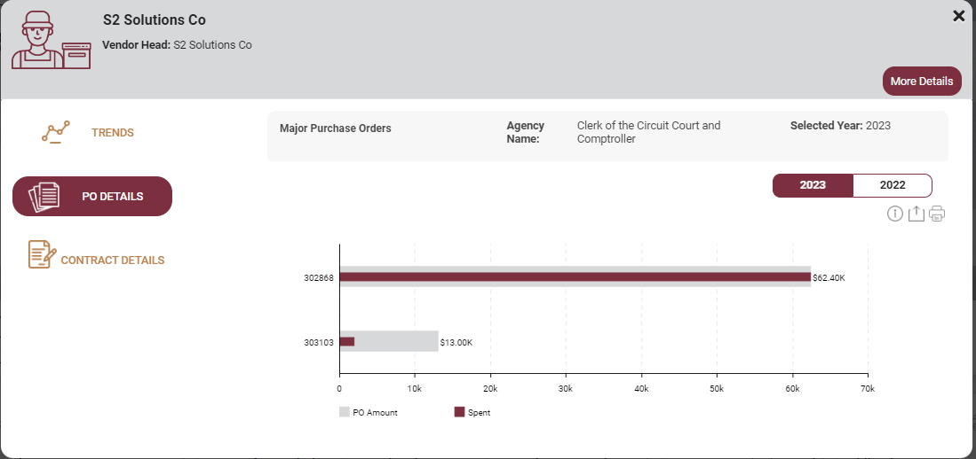
Vendor Expenses Expense Detail
Drilldown vendor detail:
Year to year trend
PO spend
Contract spend

Slide 26
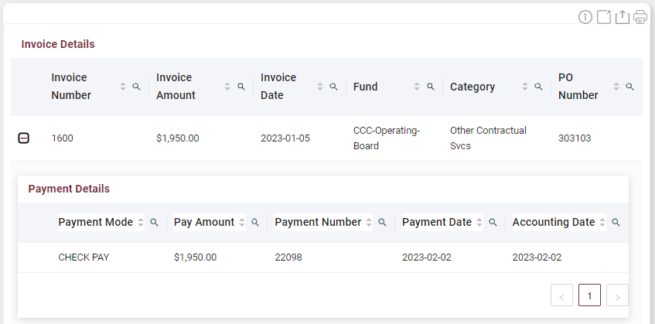
Vendor Expenses Expense Detail
Drilldown spend detail:
Invoices
Payments

Slide 27
Expenses by Departments
Departmental spend

Slide 28
Expenses by Departments
Department spend data
Organized by agency and fiscal year
Includes past five fiscal years
Visualizations for total department spend, combined expenses, and top departments based on budget amount.
Detail by main department, cost center, current year spend, current year obligation, current year budget, and last year spend

Slide 29
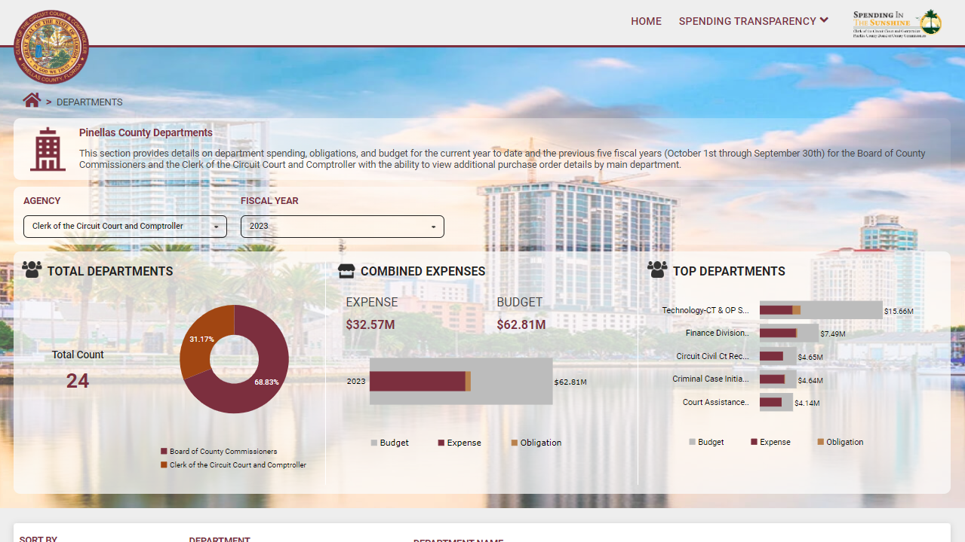

Slide 30
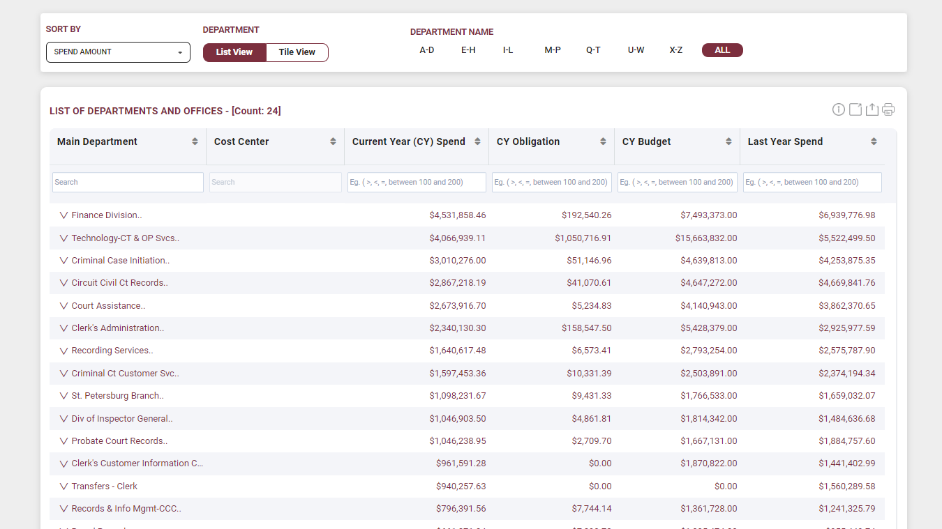

Slide 31
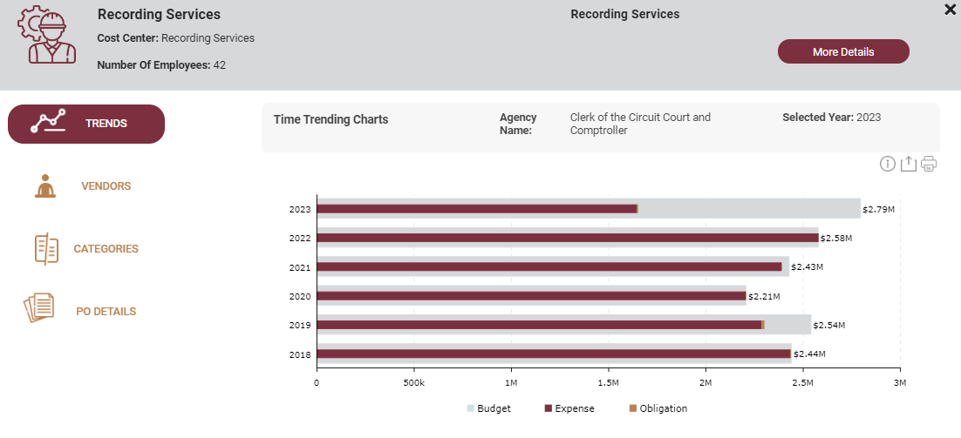
Expenses by Departments
Year to year trend data by department

Slide 32
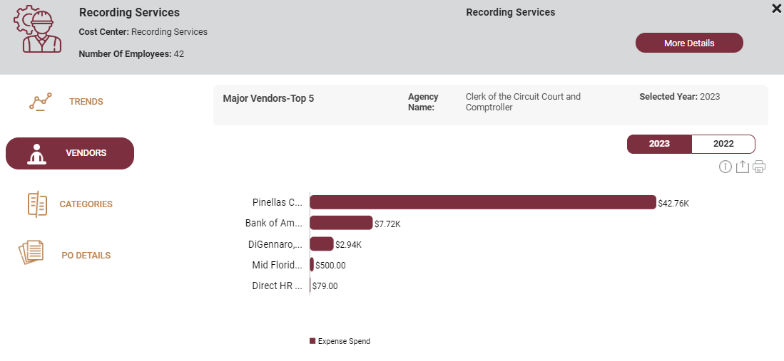
Expenses by Departments
Drilldown into departments by vendors

Slide 33
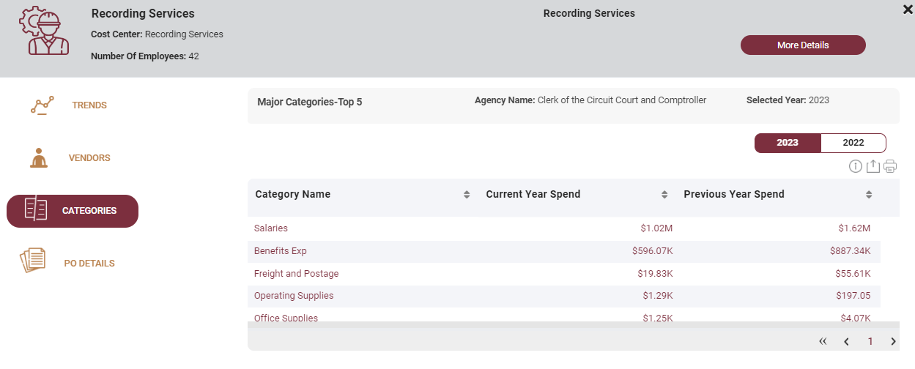
Expenses by Departments
Drilldown into Department by Category

Slide 34
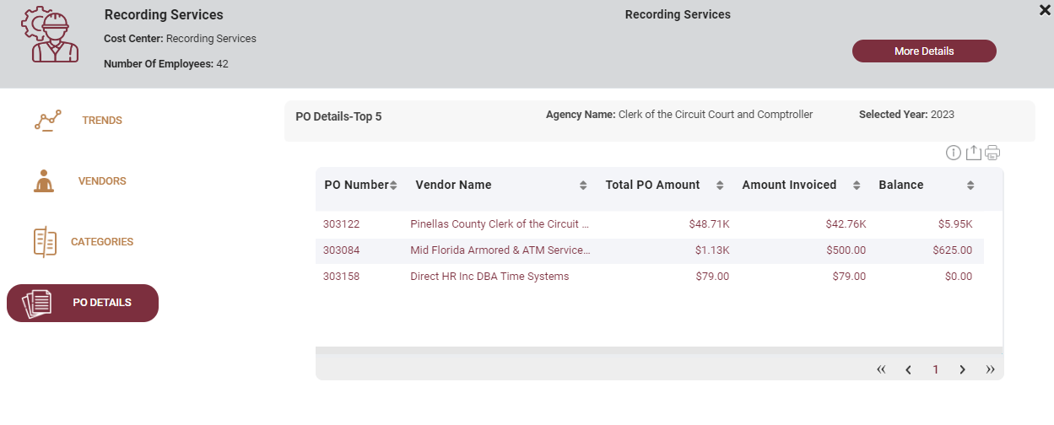
Expenses by Departments
PO Detail for Department

Slide 35
Expenses by Category
Spend by main category

Slide 36
Expenses by Category
Vendor spend data
Organized by agency and fiscal year
Includes past five fiscal years
Visualizations for top categories, personal services, and operating expenses
Detail by main category, associated vendors, departments, current year spend, obligation, and prior year spend

Slide 37
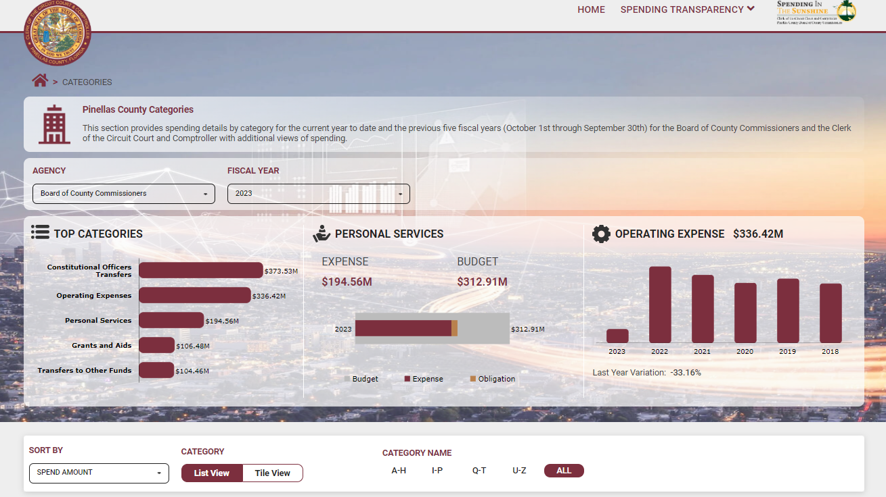

Slide 38
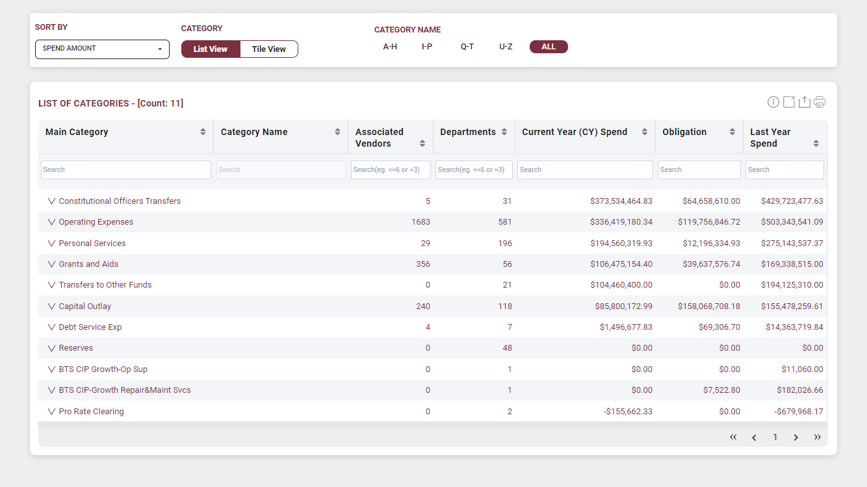

Slide 39
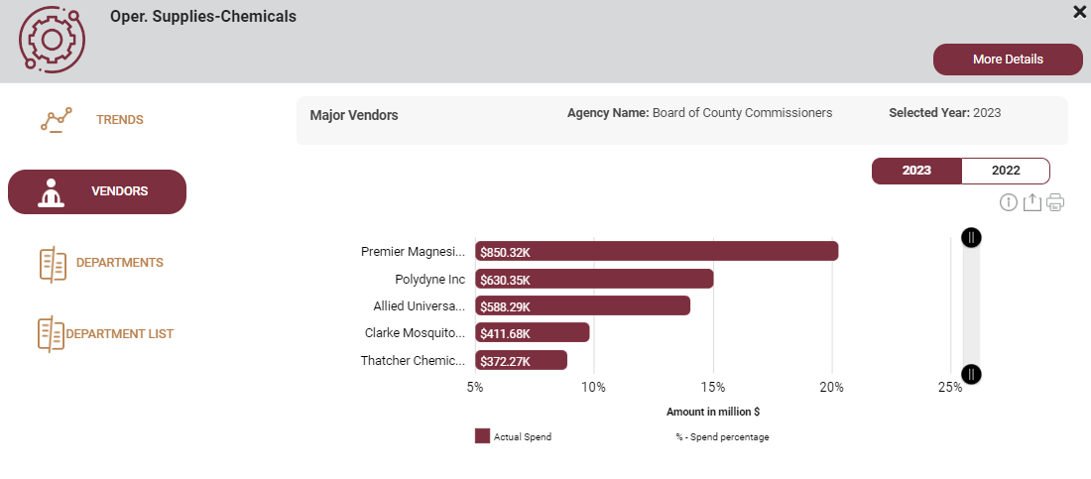
Expenses by Category
Drilldown into categories by vendor

Slide 40
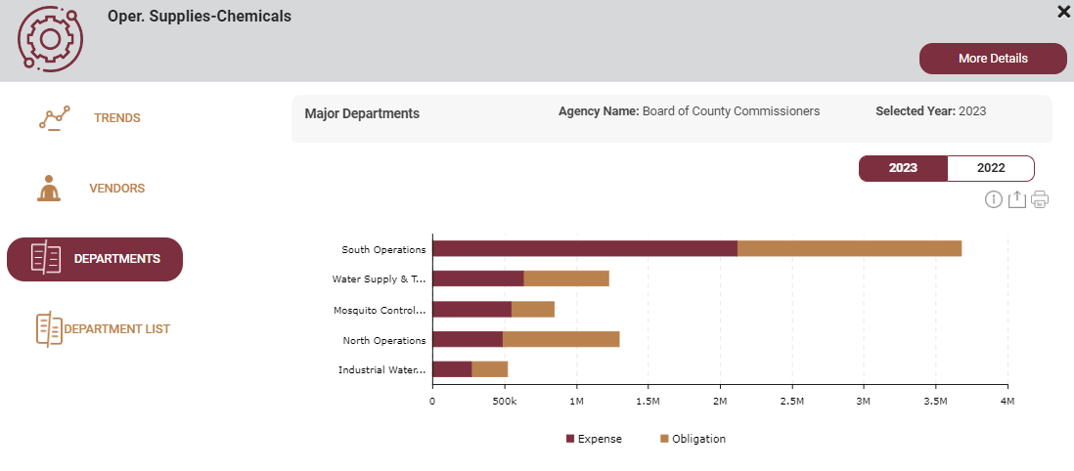
Expenses by Category
Drilldown into categories by departments

Slide 41
Legal Concerns

Slide 42
Legal Concerns
Although the public has a right of access to the records of the state and local governments recognized in our Florida Constitution and state law, some of the records showing government expenditures contain information that is confidential or exempt from that law.
Because of this, and our desire to preserve the confidential and exempt nature of those records, a review before posting was needed.
As a result of that review, legal found the following areas where protection existed.

Slide 43
Legal Concerns
Examples of areas that have been identified as potentially containing exempt and/or confidential information under Chapter 119.
Claims files maintained by any risk management program administered by the State or its political subdivisions are confidential and exempt pursuant to § 768.28(16)(b) until the termination of all litigation and settlement of all claims arising out of the same incident. Such file would include payments made to expert witnesses, surveillance companies and other vendors hired to evaluate such claims.
Attorney-client work product is exempt until the conclusion of litigation or adversarial proceedings pursuant to § 119.071(1)(d)1, Fla. Stat. This exemption specifically applies to records that reflect “a mental impression, conclusion, litigation strategy, or legal theory of the attorney or the agency.” Payment of expert witness fees are protected hereunder.

Slide 44
Legal Concerns
Economic Development incentive agreements that contain an entity’s interest in or plans to locate or expand its business activities in Florida are temporarily confidential if the entity makes such request in writing. See, § 288.075(2)(a)1, Fla. Stat.
Development plans, financial records, financial commitment letters and draft memoranda of understanding may also fall within the protection provided by the exemption and are confidential.
Information given to the Convention and Visitor’s Bureau which, if released, would reveal the identity of persons or entities who respond to a promotion effort, advertisement, or research project is exempt from disclosure pursuant to §125.0104(9)(d)1, Fla. Stat.

Slide 45
Legal Concerns
Emergency Medical Services has the potential to issue refunds to individuals transported by ambulance. Records of such refunds are confidential and exempt pursuant to HIPAA regulations and guidance issued by the federal government construing same.
Records identifying employees participating in deferred compensation/457(b) plans and any information about their elections or accounts are confidential and exempt.
Payments made to any medical provider that would identify the person receiving treatment, including but not limited to employees, claimants or clients served by the County (i.e., Health and Human Services) are confidential and exempt.

Slide 46
Legal Concerns
Trade secrets or proprietary business information are exempt.
Payments made to laboratories that would identify individuals subject to drug or alcohol testing are confidential and exempt.
Security, including cybersecurity, of the design, construction, and operation of the network and associated services and products are exempt.
“Exemption” is defined to mean “a provision of general law which provides that a specified record or meeting, or portion thereof, is not subject to the access requirements of § 119.07(1), § 286.011, or § 24, Article I of the State Constitution.”
“Confidential” in the Statutes is not subject to inspection by the public and may only be released to those persons and entities designated in the Statute.

Slide 47
Legal Concerns
“Site Disclaimer” information presented on this website is collected, maintained, and provided for the citizens of Pinellas County. While every effort is made to keep such information accurate and up-to-date, the information presented is unaudited. The Pinellas County Clerk of Court and Comptroller (Clerk) may make changes to information at any time to add or update the information provided. Persons using this website should understand it is their determination on how suitable the information is for their use. The data provided has been produced from records maintained by the Clerk in the normal course of business; however, the Clerk offers no warranty expressed or implied regarding accuracy, completeness, or usefulness of the data presented. Additionally, information that is confidential or exempt from disclosure pursuant to Florida’s public records law is not included on this website. Under no circumstances shall the Clerk or its employees be held liable for any actions taken, proper or improper, incorrect use of, or omissions made from reliance on any information contained herein.

Slide 48
Legal Concerns
Remember, the right of access is broadly construed and the only exceptions to that right which are legally allowed are those established by law or by the Constitution.

Slide 49
Technical Architecture

Slide 50
High Level Process Flow

Slide 51
High Level Process Flow
On-Prem Pinellas Source
Source tables are available on the on-prem Pinellas Oracle database. The snapshot logs are created on top of all the source tables to identify changed source records for streaming.
Kafka
Kafka is a distributed event streaming platform which is used here for data sync between Oracle and Snowflake hosted on Azure virtual machine. There is a custom Kafka Java producer which connects to Oracle and reads the snapshot logs and gets the incremental data based on RowID.
Snowflake (Target)
Snowflake is a landing area for Kafka. All the raw tables and other application related objects are created here which are explained in detailed in the detailed architecture diagram.

Slide 52
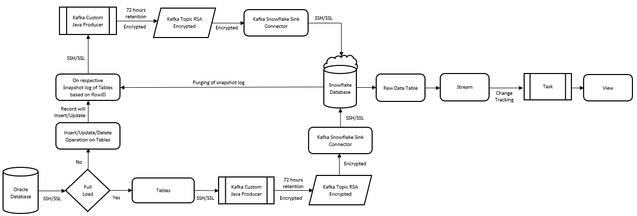
Detailed Flow for Streaming

Slide 53
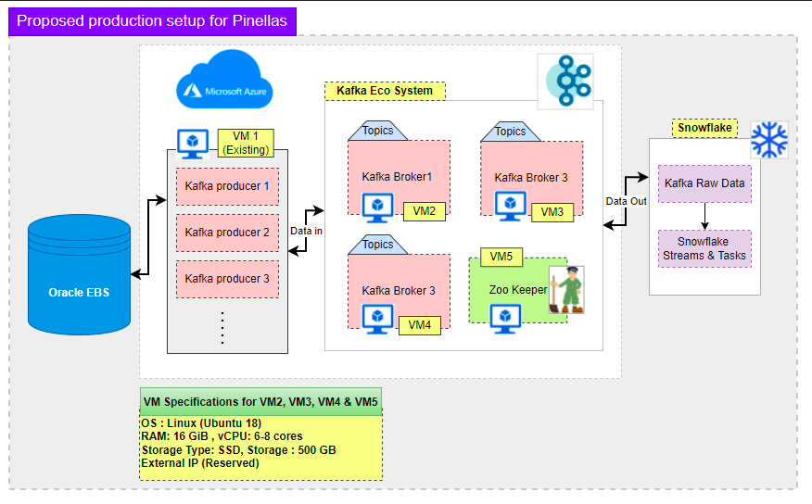
Detailed Architecture Diagram

Slide 54
Detailed Architecture Diagram
Kafka Producer
Kafka Producer API allows applications to send streams of data to the Kafka cluster.
Kafka Consumer
Kafka Consumer API allows applications to read streams of data from the cluster.
Kafka Broker
Kafka broker receives messages from producers and stores them on disk keyed by unique offset. A broker can return a unique message from topic, partition, and offset to the consumer on request

Slide 55
Detailed Architecture Diagram
Azure-based Virtual machines are widely used in the architecture. The Kafka Components used in the above architecture are three Kafka Producers installed on one virtual machine and Kafka Brokers installed on three corresponding virtual machines. Zookeeper is running on a separate virtual machine, as mentioned in the diagram.
Java based connector and CDC (Change Data Capture) connector pulls data from Oracle and transforms the data into json, and delivers it to Kafka topic, the only Kafka Producer mentioned in the above diagram. Kafka Broker pulls the data from the Kafka Topic, and using Snowflake Kafka Connectivity, and data is pushed to Snowflake.
The entire process is running in terms of daily load for 50 tables - moving from Oracle to Snowflake, scheduled every Sunday, and Payload for 14 tables scheduled every Wednesday. We are running the CDC for tables via airflow for 64 tables which is scheduled during weekdays only.

Slide 56
Data Flow

Slide 57
Data Flow
Snowflake Data Flow diagram shows detailed data flow across snowflake schemas (data layers). There are 3 schemas in snowflake database:
KAFKA_SITS_TEST_SCHEMA
Raw Tables: This is the landing area for Kafka streaming. All the raw tables are created inside this schema.
Views: Views are created on the top of raw tables to get all the latest records from source
Streams: Streams are created on the top of raw tables to track changed records.
Tasks: Tasks are created to push the data from the streams into incremental tables.
Incremental Tables. These tables are populated once task runs.
INNIVE_INFORMATION
Static Tables: There are 3 static tables – Category, Cost Center & Pinellas Exclusion List
Information Tables: Data transformation on top of raw tables
3. INNIVE_REPORTING
UI Tables: SITS application is pointed to this scheme to get data from UI tables.
DBT tool is used to load & transform data in INNIVE_REPORTING & INNIVE_INFORMATION schemas.

Slide 58
Quality Control
Transparency Website Maintenance

Slide 59
Quality Control
Even though the transparency site may be pulling from your financial system, it’s still important to perform routine reviews to verify:
Site stability
Up to date information
Financial accuracy
Proper display (and exclusion) of information

Slide 60
Quality Control
Factors to consider:
Accounting periods
Identify transactions that must be excluded
Determine how to group transactions to minimize maintenance
Manually exclude items that cannot be grouped

Slide 61
Quality Control
Payroll
Performed after each Payroll
Confirm department, position title, base salary, YTD earnings
Spot check as needed
Payables
Monthly, test to compare the website to Accounts Payable for transactions within a fiscal period
Confirm invoices either for a specific vendor, department, or spending category
Verify excluded invoices are not viewable either by category or vendor
Spot check as needed
General Ledger
Monthly, compare department totals on website to same department in ledger
Spot check as needed

Slide 62
Success Stories & Impact
Examples from our implementation

Slide 63
Success Stories & Impact
Records requests from the media
Prospective vendors
On-demand information to Commissioners
Usage by internal departments

Slide 64
Thank you!
Daniel Coughenour
Manager, Financial Accounting
dcoughenour@mypinellasclerk.gov

Slide 65
Q & A

