Slide 1
GASB 96 and Lessons Learned from GASB 87
Presented By: Jeff Wolf

Slide 2
Agenda
Review of GASB 87 – Leases
Lessons Learned – GASB 87
GASB 96 – Subscription-Based Information Technology Arrangements (SBITA)

Slide 3
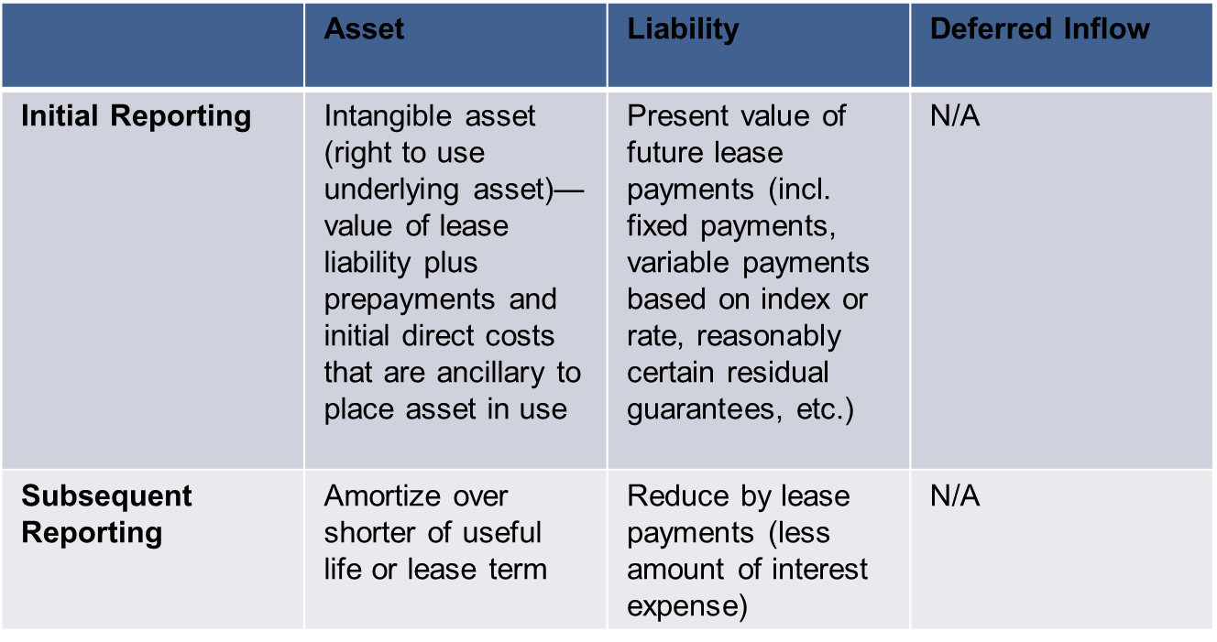
Review of GASB 87 - Leases
Lessee Accounting

Slide 4
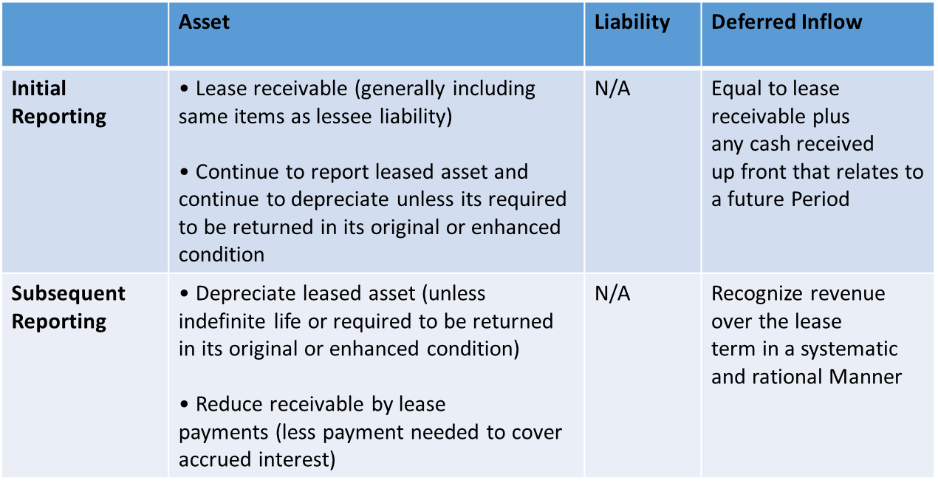
Review of GASB 87 - Leases
Lessor Accounting

Slide 5
Review of GASB 87 - Leases
Lessee Re-Measurement
Lessee should re-measure the lease liability and asset at subsequent financial reporting dates if one or more of the following changes have occurred, and the changes individually or in aggregate are significant:
Change in the lease term
Contract option elections previously determined are changed
Any event specified in the contract that requires an extension or termination takes place
Note - If the adj. (re-measure) is greater than the CV of asset difference reported in activity statement

Slide 6
Review of GASB 87 - Leases
4.51. Q—Halfway through a 10-year lease, a lessor remeasures the lease receivable from $500,000 to $10,000, due to a reduction in the lease term. The related deferred inflow of resources balance at that date is $480,000. How does the remeasurement of the lease receivable affect the measurement of the remaining deferred inflow of resources?
A—The lessor should reduce the lease receivable by $490,000 and the deferred inflow of resources by $480,000 and recognize an outflow of $10,000. According to paragraph 54 of Statement 87, the deferred inflow of resources generally should be adjusted by the same amount as the corresponding lease receivable when the receivable is remeasured. However, if that change reduces the carrying value of the deferred inflow of resources to zero, any remaining amount should be reported as an outflow in the resource flows statement (for example, a loss).

Slide 7
Review of GASB 87 - Leases
4.8. Q—Paragraph 19 of Statement 87 requires that certain contracts be reported as financed purchases of the underlying asset. How should a financed purchase be reported by a governmental buyer and a governmental seller?
A—In a financed purchase, a buyer acquires a capital asset from a seller. In exchange, the buyer promises to make payments over time for that capital asset. Therefore, the buyer has financed the acquisition of the capital asset. The provisions applicable to a financed purchase by a governmental buyer, including disclosures, are those related to capital assets and to long-term debt or payables, depending on the terms of the financing. The provisions applicable to a financed purchase by a governmental seller are those related to long-term receivables. Additionally, because the transaction is a sale of a capital asset, a governmental seller should recognize a gain or loss (if applicable) in financial statements prepared using the economic resources measurement focus.

Slide 8
Review of GASB 87 - Leases
4.1. Q—A lease contract states that it will remain in effect for three years unless terminated before then. The contract allows the lessee to terminate the lease for any reason with 60 days notice. The contract allows the lessor to terminate the lease with 60 days notice only if the lessee defaults on payments. Is this a short-term lease?
A—No. Although the lessee has an unconditional right to terminate, the lessor does not have an unconditional right to terminate because the lessor is allowed to terminate the lease only on the condition that the lessee defaults on payments. Accordingly, there are no periods for which both the lessee and lessor have an option to terminate and, therefore, no cancellable periods to exclude from the maximum possible term, which is three years.

Slide 9
Review of GASB 87 - Leases
4.2. Q—A lease has a noncancellable period of 36 months, and the lessee has an option to extend the lease for an additional 12 months. At commencement of the lease, it is not reasonably certain that the lessee will exercise that option. At the end of the 2 noncancellable period, the lessee exercises the option to extend the lease. Does exercising the option to extend result in a change to the maximum possible term?
A—No. In accordance with paragraph 16 of Statement No. 87, Leases, the maximum possible term at commencement includes all options to extend, regardless of their probability of being exercised. At the commencement of the lease, the lease term is 36 months, and the maximum possible term is 48 months. As a result, although the reassessed lease term is only 12 months from the exercise date, the maximum possible term remains 48 months when the option is exercised. In addition, although some lease modifications are accounted for as separate leases for which the maximum possible term would be assessed separately, exercising an existing option is not a lease modification in accordance with paragraph 71 of Statement 87.

Slide 10
Review of GASB 87 - Leases
4.4. Q—A government leases a building. The lease term is 10 years. At the commencement of the lease, the government provides payment for the first three years and recognizes a liability for the present value of the payments for the remaining seven years, which will be paid starting in the fourth year of the lease. Should the government recognize interest expense during the first three years of the lease?
A—Yes. In accordance with paragraph 24 of Statement 87, interest expense represents the amortization of the discount on the lease liability. That discount should be amortized over the entire lease term, including the first three years during which the government is not making payments. The interest liability will continue to accrue until the government starts making payments in the fourth year.

Slide 11
Review of GASB 87 - Leases
4.5. Q—A public university enters into a lease of a building in Europe for its study abroad program. The lease requires the university to make payments of 5,000 euros per month. The university prepares its financial statements in U.S. dollars. Because the lease payment is required to be made in euros, the amount of the payment in U.S. dollars is subject to change throughout the lease as exchange rates fluctuate. Are those lease payments variable payments that depend on an index or a rate?
A—No. The currency in which lease payments are made does not affect whether those payments are considered fixed. As such, because the contract requires a fixed payment amount in euros, the lease payments should be considered fixed payments for the purpose of applying paragraph 21 of Statement 87. The increase or decrease in expected U.S. dollar cash flows is a foreign currency transaction gain or loss, which should be reported in accordance with paragraphs 165–172 of Statement No. 62, Codification of Accounting and Financial Reporting Guidance Contained in Pre-November 30, 1989 FASB and AICPA Pronouncements.

Slide 12
Review of GASB 87 - Leases
4.6. Q—Paragraph 54 of Statement 87 requires that the deferred inflow of resources related to a lease be recognized as inflows of resources (for example, revenue) over the term of the lease. If reported as revenue, should a business-type activity or enterprise fund report those inflows of resources as operating revenue?
A—Paragraph 102 of Statement No. 34, Basic Financial Statements—and Management’s Discussion and Analysis—for State and Local Governments, requires governments to establish a policy that defines operating revenues in a way that is appropriate to the nature of the activity being reported. As discussed in Question 7.73.4 in Implementation Guide No. 2015-1, that policy should be consistent with the objective of distinguishing between operating and nonoperating revenues and expenses, which is to provide a reporting format that displays the extent to which an enterprise’s operating expenses were covered by revenues generated by its principal ongoing operations. Therefore, whether revenue recognized from the deferred inflow of resources related to a lease is operating revenue or nonoperating revenue depends on (a) the purpose of the lease, (b) the nature of the activity being reported as a business-type activity or in an enterprise fund, and (c) the government’s policy defining operating revenue.

Slide 13
Lessons Learned – GASB 87
RTU asset is a capital asset
Lease liability should be disclosed with long-term liabilities
Interest rates
Initial and subsequent recording
Materiality
Note disclosures
Policies and procedures

Slide 14
GASB 96 - SBITA
Subscription-Based Information Technology Arrangements – This Statement provides guidance on the accounting and financial reporting for SBITAs for government end users (governments).
GASB 96:
defines a SBITA;
establishes that a SBITA results in a right-to-use subscription asset—an intangible asset—and a corresponding subscription liability;
provides the capitalization criteria for outlays other than subscription payments, including implementation costs of a SBITA; and
requires note disclosures regarding a SBITA.

Slide 15
GASB 96 - SBITA
This Statement does not apply to:
Contracts that convey control of the right to use another party’s combination of IT software and tangible capital assets that meets the definition of a lease in Statement No. 87, Leases, in which the software component is insignificant when compared to the cost of the underlying tangible capital asset (for example, a computer with operating software or a smart copier that is connected to an IT system).
Governments that provide the right to use their IT software and associated tangible capital assets to other entities through SBITAs.
Contracts that meet the definition of a public-private and public-public partnership in paragraph 5 of Statement No. 94, Public-Private and Public-Public Partnerships and Availability Payment Arrangements.
Licensing arrangements that provide a perpetual license to governments to use a vendor’s computer software, which are subject to Statement No. 51, Accounting and Financial Reporting for Intangible Assets, as amended.

Slide 16
GASB 96 - SBITA
Definition: For the purposes of applying this statement, a SBITA is contract that conveys control of the right to use another party’s (a SBITA vendor’s) IT software alone or in combination with tangible capital assets (the underlying IT assets), as specified in the contract for a period of time in an exchange or exchange‐like transaction.
Control of the Right to Use (judgement required)
Obtain present service capacity
Determine the nature and manner of use

Slide 17
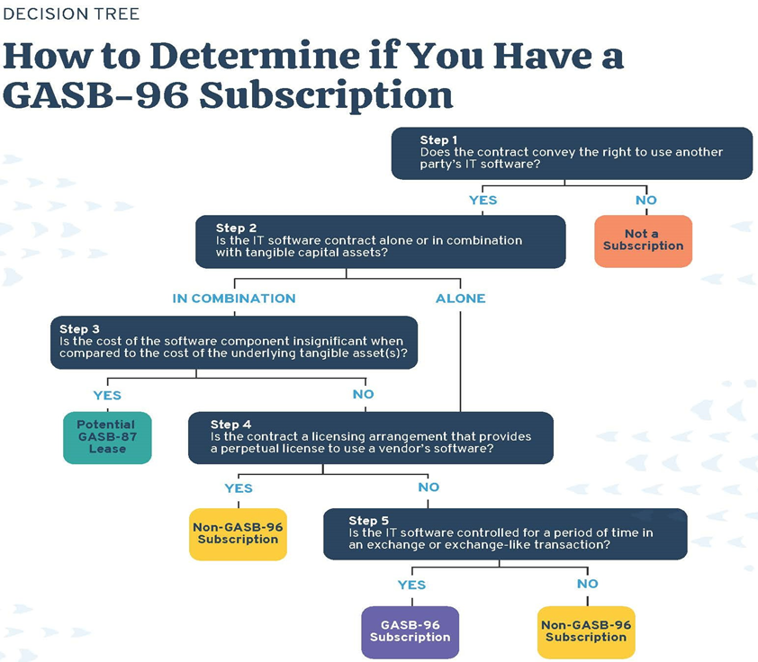
GASB 96 - SBITA

Slide 18
GASB 96 - SBITA
Term includes period in which a government has a noncancelable right to use the underlying IT assets, as well as options to extend/terminate, if reasonably certain government or vendor will extend/will not terminate
Generally, recognize right‐to‐use subscription asset (intangible) and corresponding subscription liability
Subscription liability initially measured at present value of subscription payments expected to be made during the subscription term, discounted using rate charged by vendor or incremental borrowing rate
GASB 99 Amendment to clarify what an option to terminate is: “An option to terminated is an unconditional right that exists with the SBITA contract. A provision that gives a part to the SBITA the right to terminate the SBITA contract only in certain circumstances or upon the occurrence of certain events, such as the action or inaction of the other party to the SBITA contract, should not be considered an option to terminate a SBITA.

Slide 19
GASB 96 - SBITA
How to determine the subscription term?
One-year, automatic renewal and clear terms
Annual 3% renewal increase
How far out are you reasonably certain not to terminate?
Prior experience
Technological advances
Payment terms
Will depend on professional judgment
Consider creating a policy

Slide 20
GASB 96 - SBITA
How to determine the subscription term?
One-year, automatic renewal and no clear terms
Does a new contract need to be signed?
How do you determine payment terms for subsequent year?

Slide 21
GASB 96 - SBITA
Determining the Subscription Liability
Fixed payments
Variable payments that depend on an index or rate
Variable payments that are fixed in substance
Payments for penalties for terminating the SBITA
Any subscription contract incentives
Any other payments to the SBITA vendor associated with the SBITA contract that are reasonably certain of being required

Slide 22
GASB 96 - SBITA
Subscription Asset
Initial subscription liability
Add payments made to vendor before commencement of term
Add capitalizable implementation costs
Less incentives received from vendor at or before commencement
Amortization of discount on subscription liability in subsequent financial reporting periods = outflow of resources (interest expense)
Amortization of subscription asset over the subscription term = outflow of resources (amortization expense)

Slide 23
GASB 96 - SBITA
Remeasurement - A government should remeasure the subscription liability at subsequent financial reporting dates if one or more of the following changes have occurred
There is a change in the subscription term.
There is a change in the estimated amounts for subscription payments already included in the measurement of the subscription liability (except as provided in paragraph 21).
There is a change in the interest rate the SBITA vendor charges the government, if used as the initial discount rate.
A contingency, upon which some or all of the variable payments that will be made over the remainder of the subscription term are based, is resolved such that those payments now meet the criteria for measuring the subscription liability in accordance with paragraph 16. For example, an event occurs that causes variable payments that were contingent on the performance or use of the underlying IT assets to become fixed for the remainder of the subscription term.

Slide 24
GASB 96 - SBITA
Costs are divided into the following groups:
Preliminary Project Stage – Not capitalized as part of the intangible asset
Evaluating alternatives, determining needed technology, and selecting a SBITA vendor
Initial Implementation Stage – Capitalized as part of the intangible asset
Any expenses incurred to place the asset into service
Exception: short-term subscription
Operation and Additional Implementation Stage – Not capitalized as part of the intangible asset
Subsequent implementation activities, maintenance, and ongoing operations
Exception: capitalize if increases the functionality or efficiency of subscription asset

Slide 25
GASB 96 - SBITA
Training Costs should be expensed, regardless of stage in which they are incurred.
Review this with your Purchasing Department to determine if you should require schedules that separate the various components (e.g., Training Costs) with SBITA contracts.

Slide 26
GASB 96 - SBITA
Additional considerations:
Guidance included for SBITA with multiple components
Exception for short‐term SBITA with a maximum possible term of 12 months or less
Recognize and measure assets and liabilities from SBITAs using facts and circumstances at the beginning of the fiscal year of implementation

Slide 27
GASB 96 - SBITA
Short-Term SBITAs
Maximum possible term is 12 months or less
Noncancellable period and options
No probability Assessment – assumes all options to extend are exercised and no options to terminate are exercised
GASB 99 Amendment – Modified short-term leases should be remeasured from inception

Slide 28
GASB 96 - SBITA
Footnote Disclosures:
General description
Include basis, terms and conditions variable payments not included in subscription liability
Be sure to list right-of-use assets separately from other capital assets
Outflows recognized for other payments not included in subscription liability (Example: termination penalty)
Principal and interest requirements to maturity
5 subsequent fiscal years and then 5 year increments thereafter
Commitments before commencement
Any loss associated with impairment

Slide 29
GASB 96 - SBITA
Common Subscription Types
ERP Systems
Lease Accounting Software
Fixed Asset Software
Tax Collection Software
Budget Software
911 and Emergency Dispatch
Water and Electric Utilities Metering
Email, Calendar and Office Tools (e.g., Microsoft Suite)
Online Conferencing Tools
Online Payment Tools
Cloud Computing Arrangements (e.g., Software as a Services, Infrastructure as a Services, Platform as a Service)
Data Backup & Storage for Tax/Appraisal Records
Any other items found through collaboration with IT departments

Slide 30
GASB 96 - SBITA
Common Subscription Types for Schools
Remote Learning Platforms
Student Information Systems
Amazon Web Services (AWS)
Records Management Systems
Library Management Systems
Teacher Evaluation Systems
Career Planning Sites
Content Management Systems
Professional Development Tracking
Emergency Notification Systems
Server Hosting Services
Cloud Storage
Email Services
Data Backup
Any other items found through collaboration with IT departments

Slide 31
GASB 96 - SBITA
Implementation Guidance
Similar to GASB 87 approach
Identity all SBITAs (Involve I.T. Department)
Discuss with other departments and constitutional officers
Review budget
Review general ledger details
Create a template with key information
Apply the standard to each possible SBITA
Consider software

Slide 32
GASB 96 - SBITA
Consider Materiality
Materiality individually and in the aggregate
Need full population to better understand where you can draw the line

Slide 33
GASB 96 - SBITA
Key Takeaways for Implementing GASB 96
Accounting is nearly identical to GASB 87
However, get familiar with the requirements of GASB 96
Is not services
Is not hardware
Is not educational arrangement on how to use software
Is not a lease as defined by GASB 87
Is not a SBITA from a government entity that provide other entities the right to use their own IT software
Commencement date (lease) vs. Implementation completion date (SBITA)
Separating subscription and nonsubscription (e.g., perpetual licenses, maintenance services) components
Identify and collect all SBITA agreements/Create master SBITA listing
Identify general ledger accounts that could contain expenditures/vendors associated with SBITA

Slide 34
GASB 96 - SBITA
Q—Is a licensing agreement for a vendor’s computer software that automatically renews until cancelled a licensing agreement that provides a perpetual license?
A—No. A provision under which a licensing agreement automatically renews until cancelled is an option to terminate the agreement at each renewal date. An agreement that includes an option to terminate is not a purchase, whereas a perpetual license is a purchase in which a government is granted a permanent right to use the vendor’s computer software. Therefore, a licensing agreement for a vendor’s computer software that automatically renews until cancelled does not provide a perpetual license

Slide 35
GASB 96 - SBITA
Q—A government enters into a six-year subscription-based information technology arrangement (SBITA) contract with no options to extend or terminate the contract and begins making semiannual subscription payments to the SBITA vendor immediately after the contract takes effect. The initial implementation stage is not completed until the end of the second year after the contract takes effect. What is the subscription term?
A—The subscription term is four years. The initial implementation stage is completed at the end of the second year of the contract. Therefore, in accordance with paragraphs 9 and 15 of Statement 96, the subscription term commences at the beginning of the third year and ends at the conclusion of the sixth year when the SBITA contract ends.

Slide 36
GASB 96 - SBITA
Q—For purposes of determining the applicability of Statement 96, do Software as a Service, Platform as a Service, and Infrastructure as a Service contain a combination of IT software and tangible capital assets?
A—Yes. Software as a Service, Platform as a Service, and Infrastructure as a Service are three common deployment models of cloud computing arrangements. Notwithstanding the labels of those arrangements, each deployment model contains IT software used in combination with tangible capital assets. To further assess the applicability of Statement 96, the substance of the arrangement should be evaluated in accordance with all aspects of paragraph 6 of that Statement to determine whether the arrangement meets the definition of a subscription-based information technology arrangement (SBITA).

